Slide 1

Real-time Image-based Driver Drowsiness Detection using Deep Learning
Group Members
Aimal Khan (20P-0028)
Saad Rahman (20P-0027)
Project Supervisor
Dr. Hafeez Anwar

Slide 2
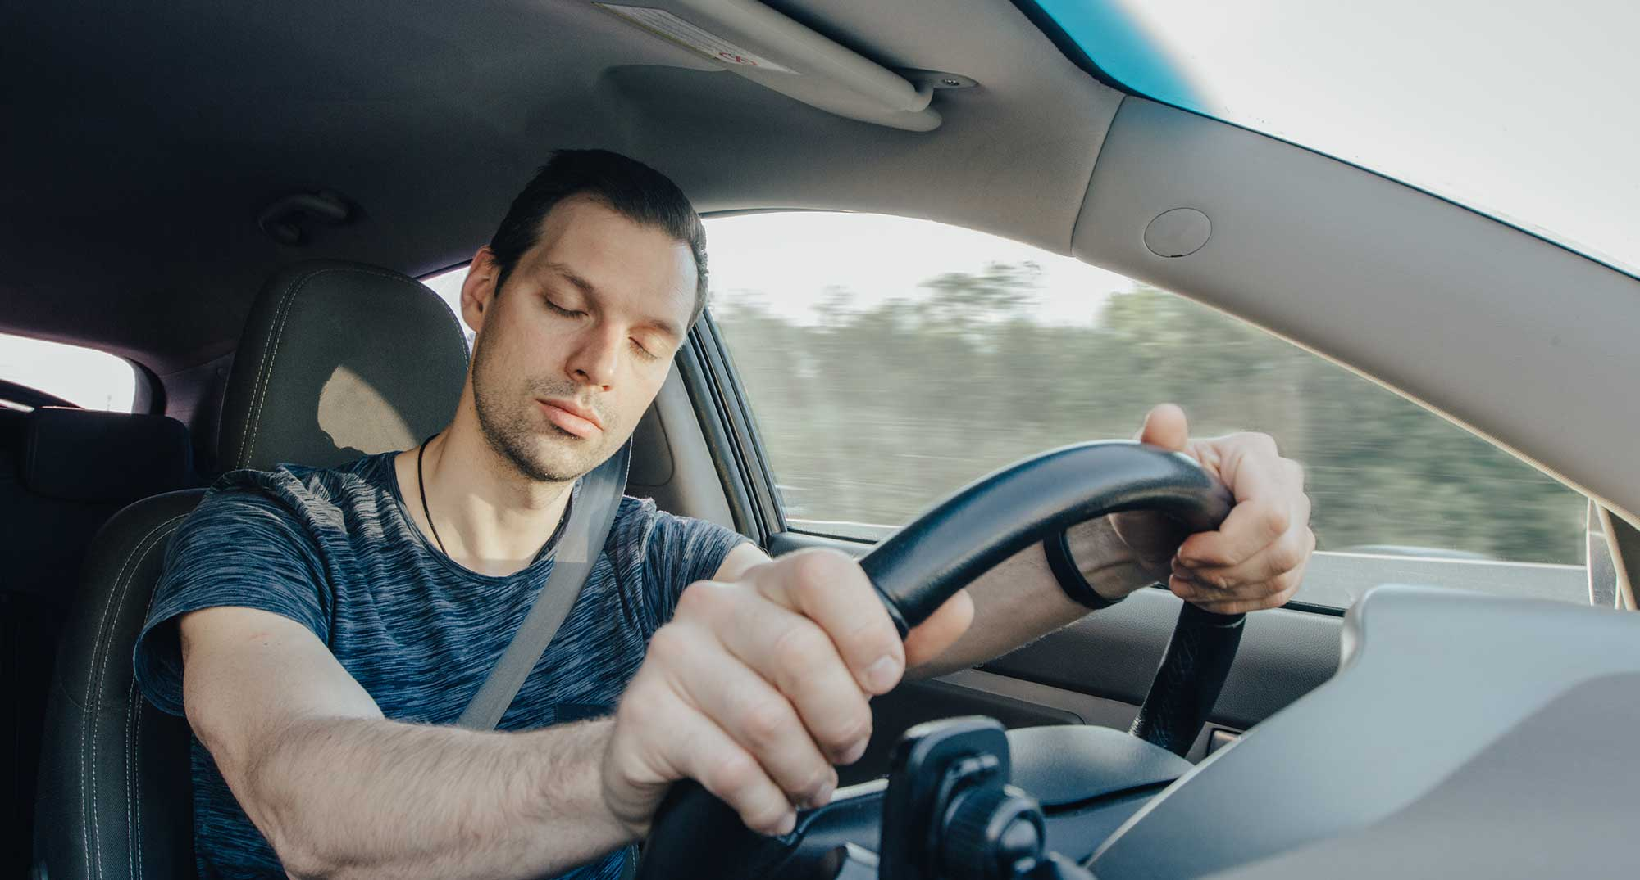
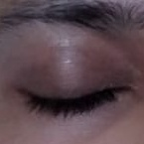
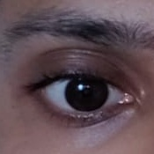
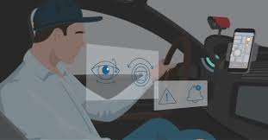
Introduction
Drowsy driving is one of the most underrated reason for car accidents. (Drowsy Driving: An Underrated Danger)
Drowsy driving impairs cognitive functions, reduces reaction times which increases the likelihood of accidents.
The US National Highway Traffic Safety Administration has estimated that worldwide every year, about 100,000 road accidents are caused by drowsiness, accounting for > 1500 deaths and > 70,000 injuries. (WHO)

Slide 3
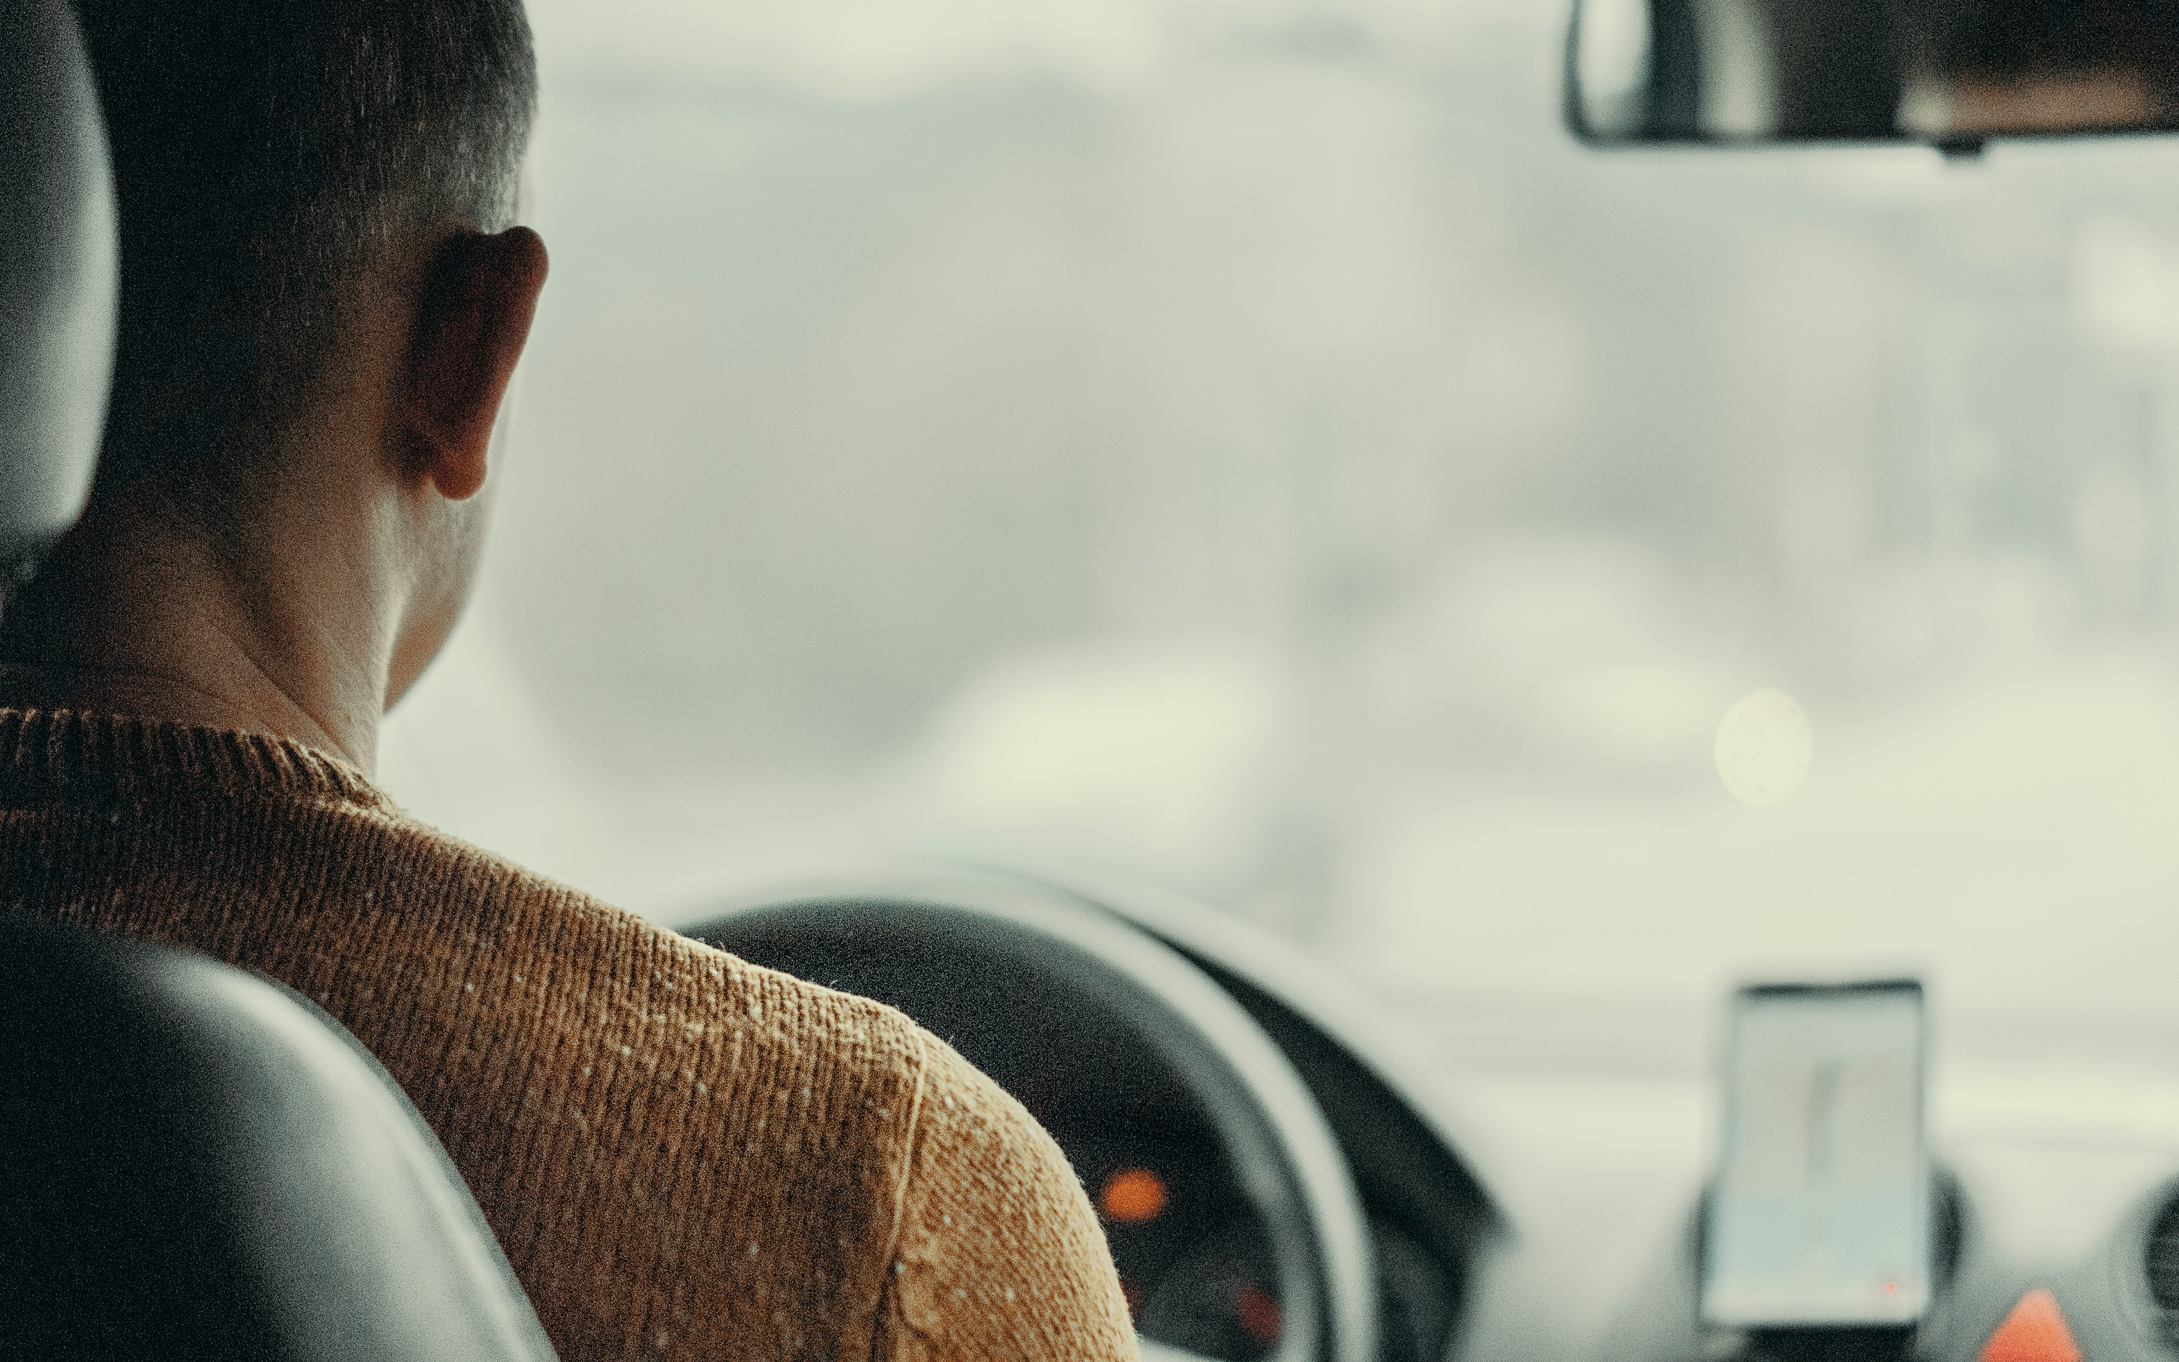
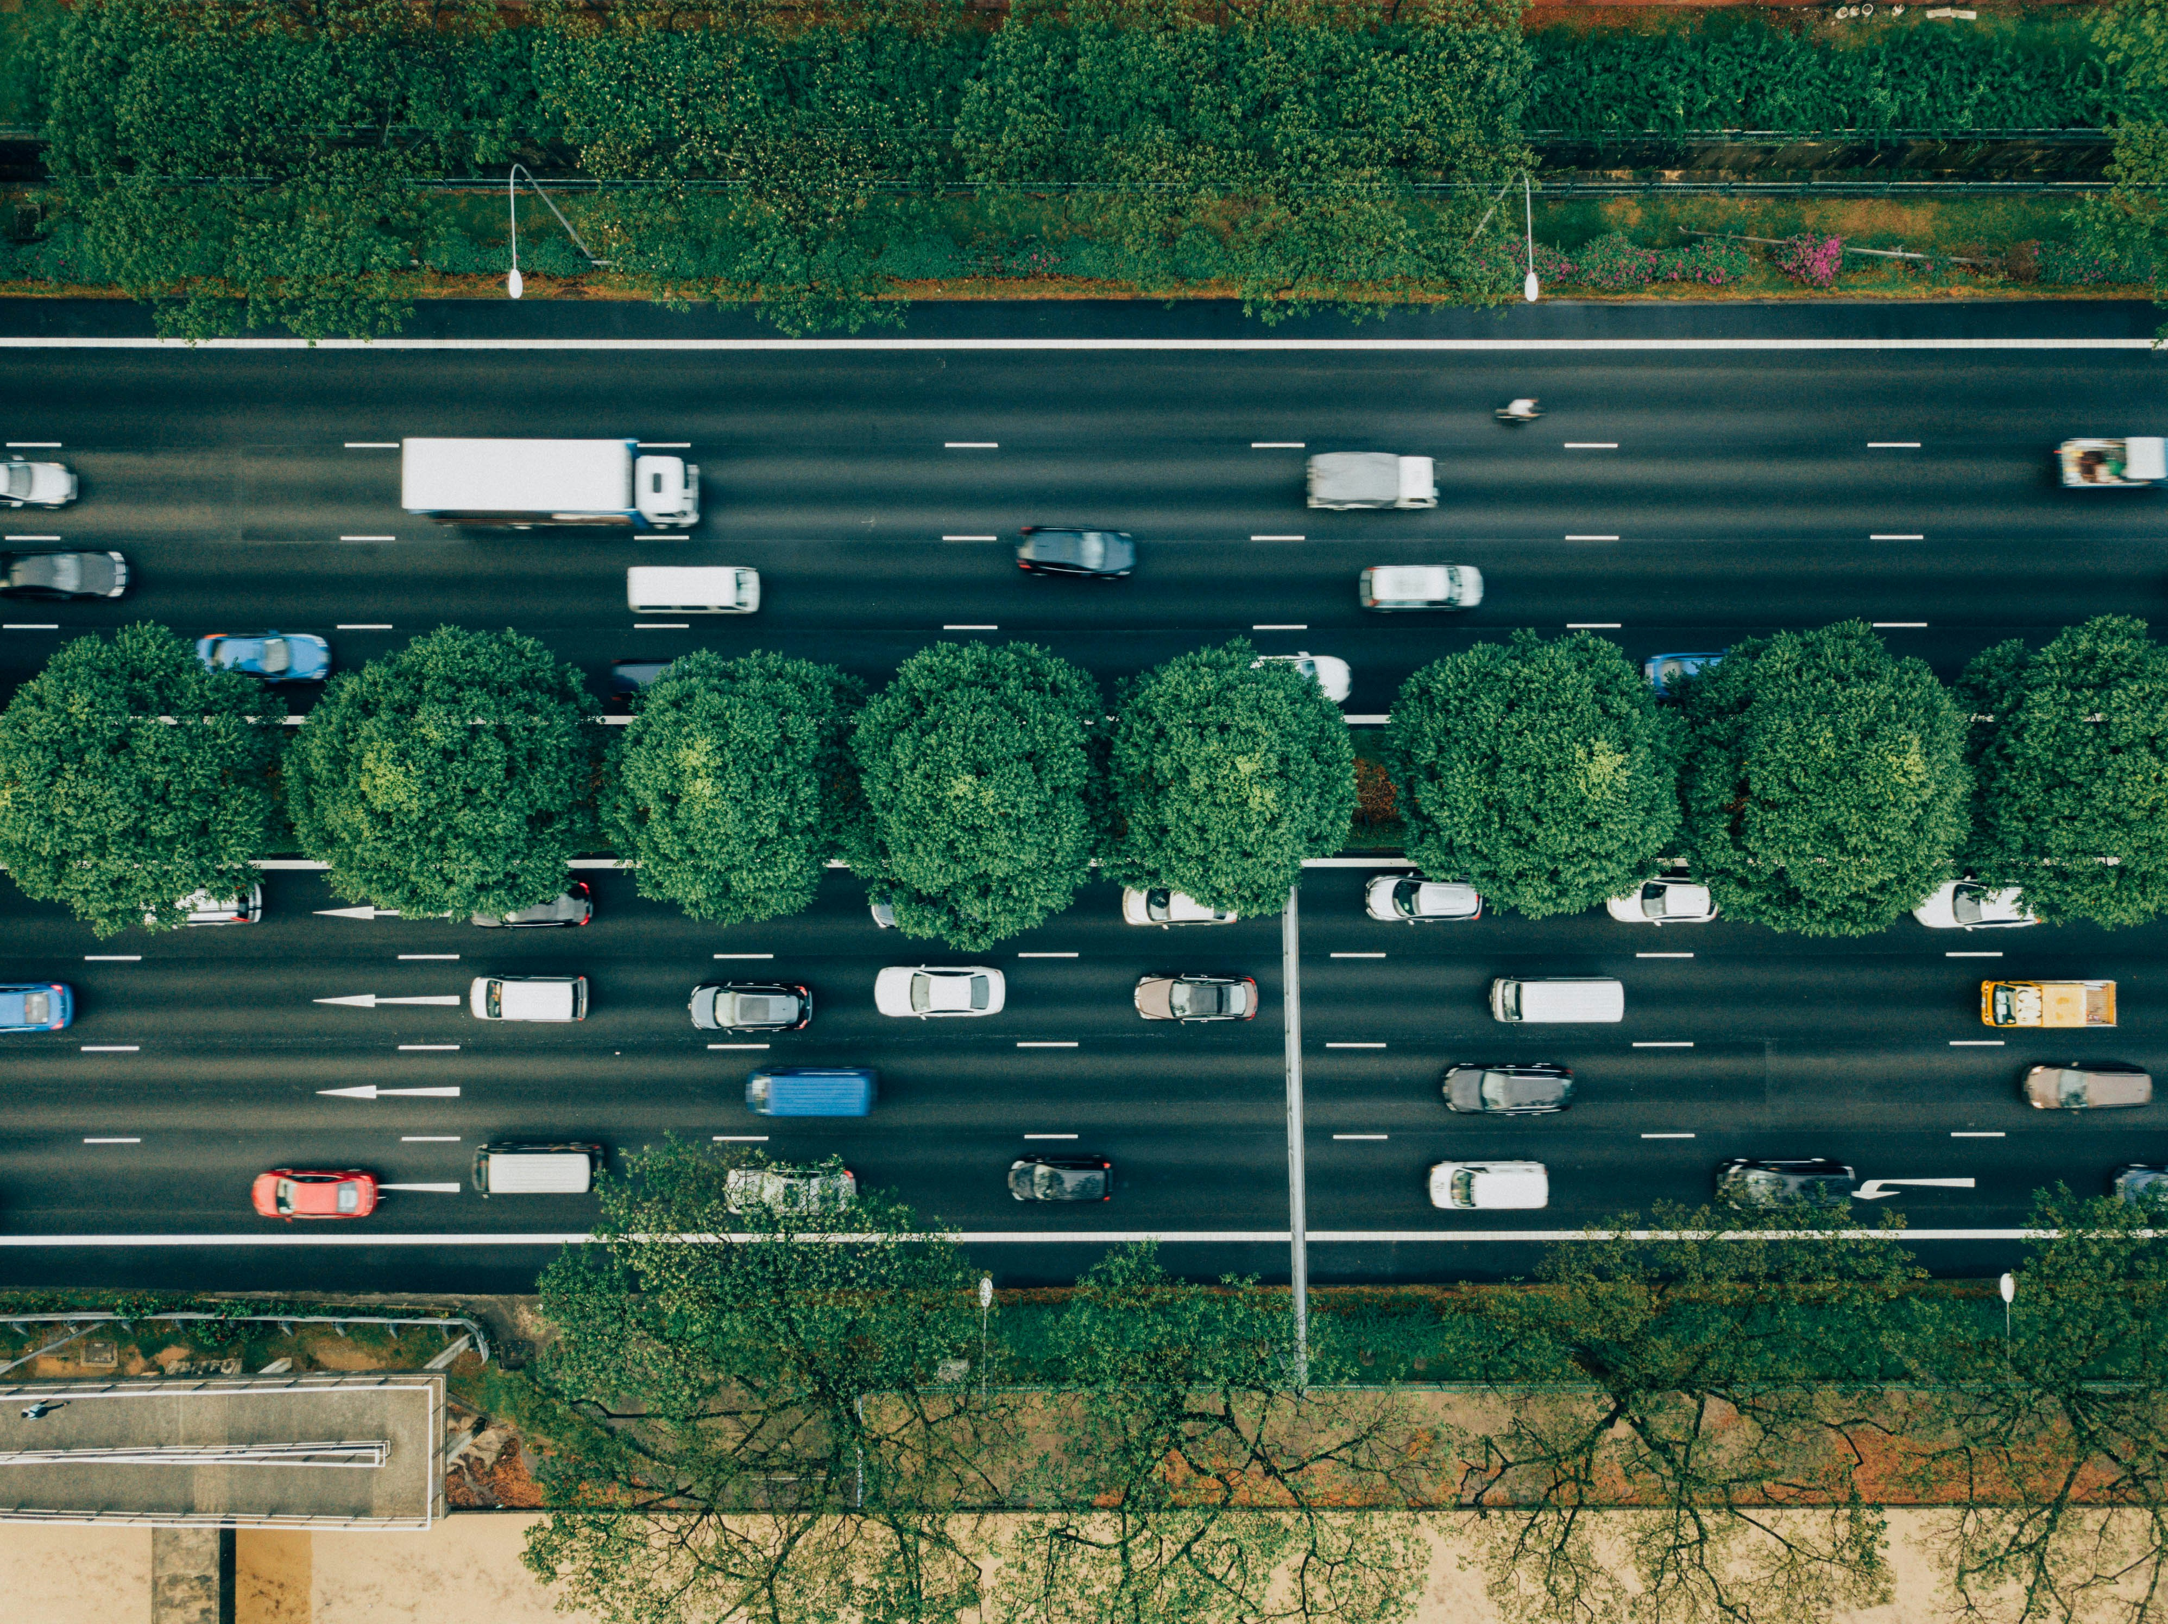
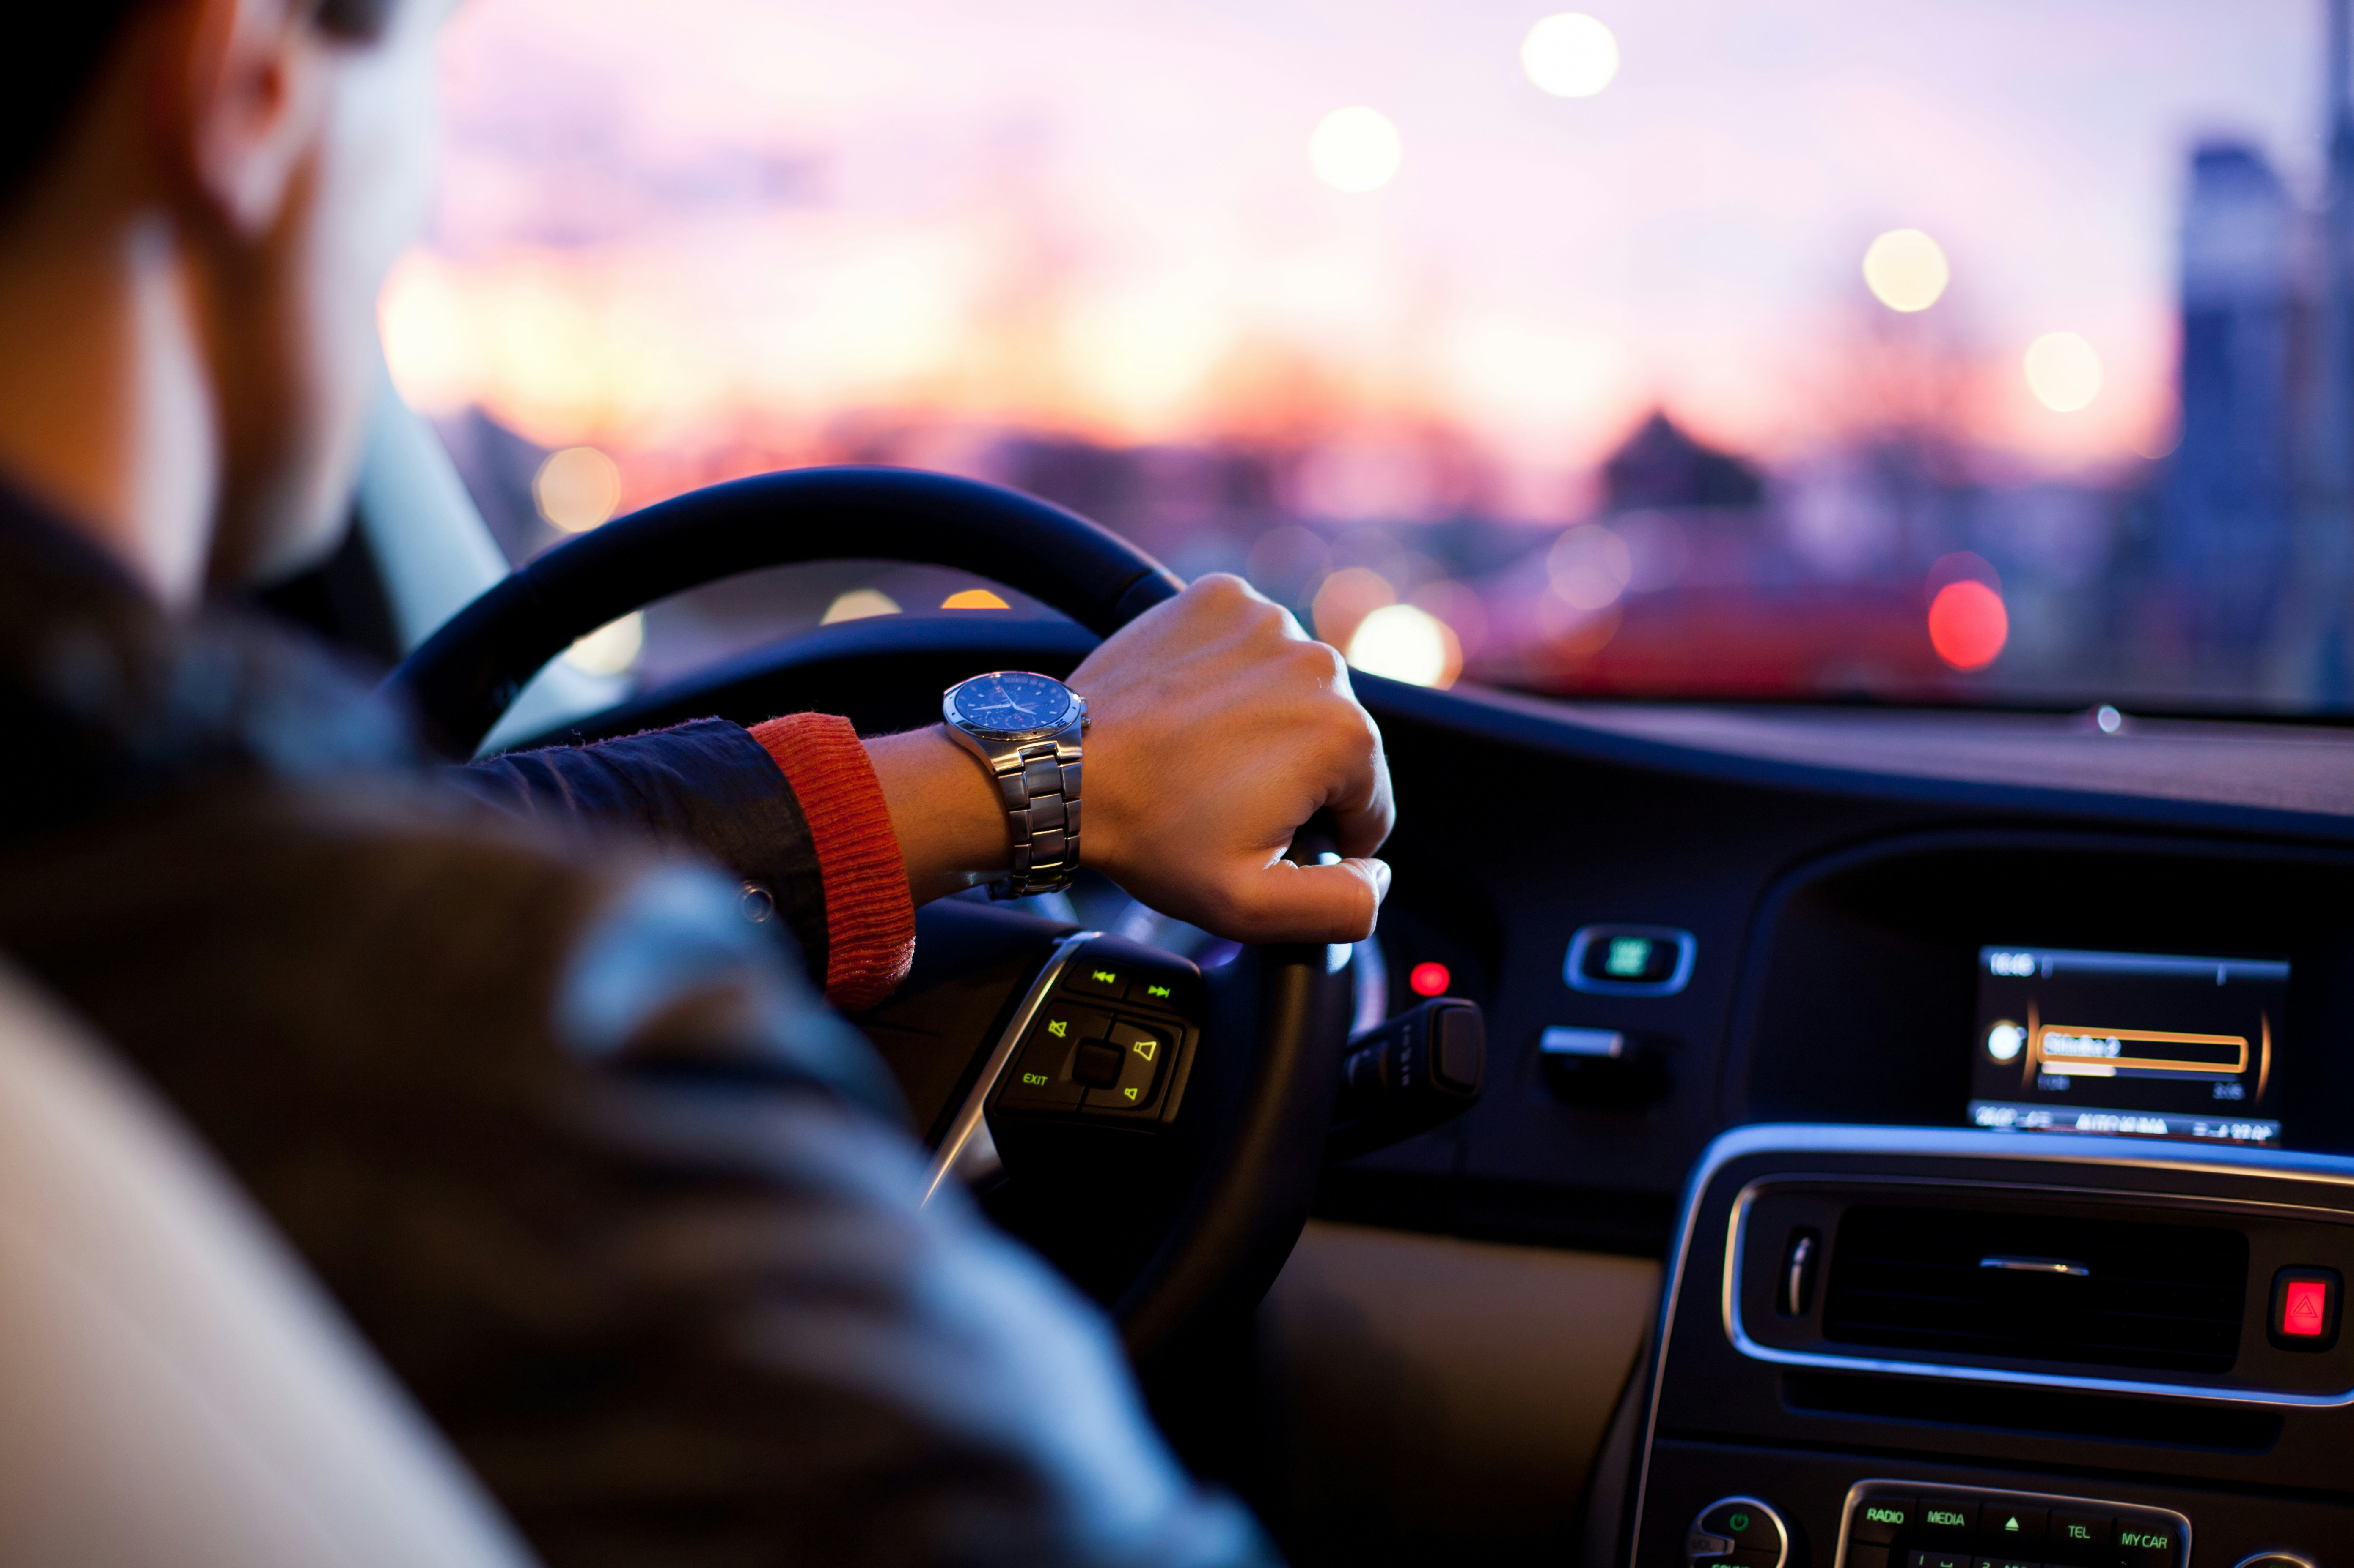
Introduction
Our project aims to enhance road safety by utilizing deep learning for real-time driver drowsiness detection through a specialized mobile application, providing timely alerts to prevent potential accidents caused by impaired driver alertness.

Slide 4
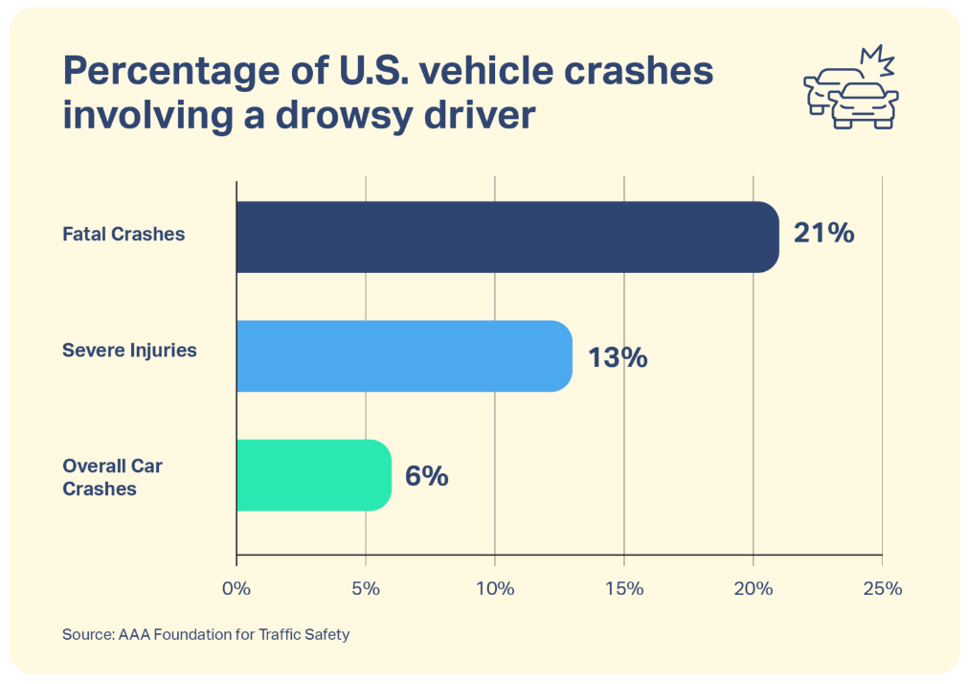
Introduction
Drowsy Driving Is a Factor in 21% of Fatal Crashes. Why Don’t We Talk About It More? – Sleep Foundation

Slide 5
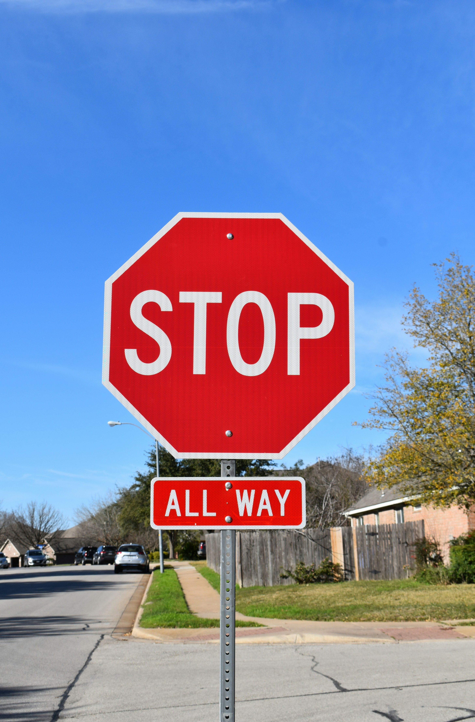


Motivation
Road Safety
Technological Advancements
Cost Effective Solution
Promoting Driver Awareness
Room For Further Advancement And Research

Slide 6
Problem Statement
Current methods for detecting driver drowsiness lack real-time accuracy and require extra hardware, making them inconvenient and less effective. There's a need for a highly accurate, real-time solution that is user-friendly and doesn't rely on additional equipment.

Slide 7
Solution
Our solution is to develop a user-friendly mobile application utilizing cutting-edge deep learning algorithms for real-time driver drowsiness detection. The application will leverage the mobile camera and mobile sensors to ensure accurate detection and timely alerts, ultimately enhancing road safety and preventing potential car accidents.

Slide 8
Scope Of Project
Our focus will be to detect driver drowsiness from real-time images of the driver and mobile sensors (considering there are many methods to detect driver drowsiness e.g. Through ECG).
Drowsiness detection will be done based on the available Image datasets and sensor datasets.
Our other area of focus will be to develop an effective alert system to alert the driver in case of drowsiness detection.
Mobile Application and Model Development.

Slide 9
Goals
Achieve a high accuracy
Achieve high battery efficiency
Achieve a good real-time detection performance
Storage Efficiency
Creation of a user friendly interface
Capability to detect drowsiness in different driving conditions
Document the complete development process

Slide 10
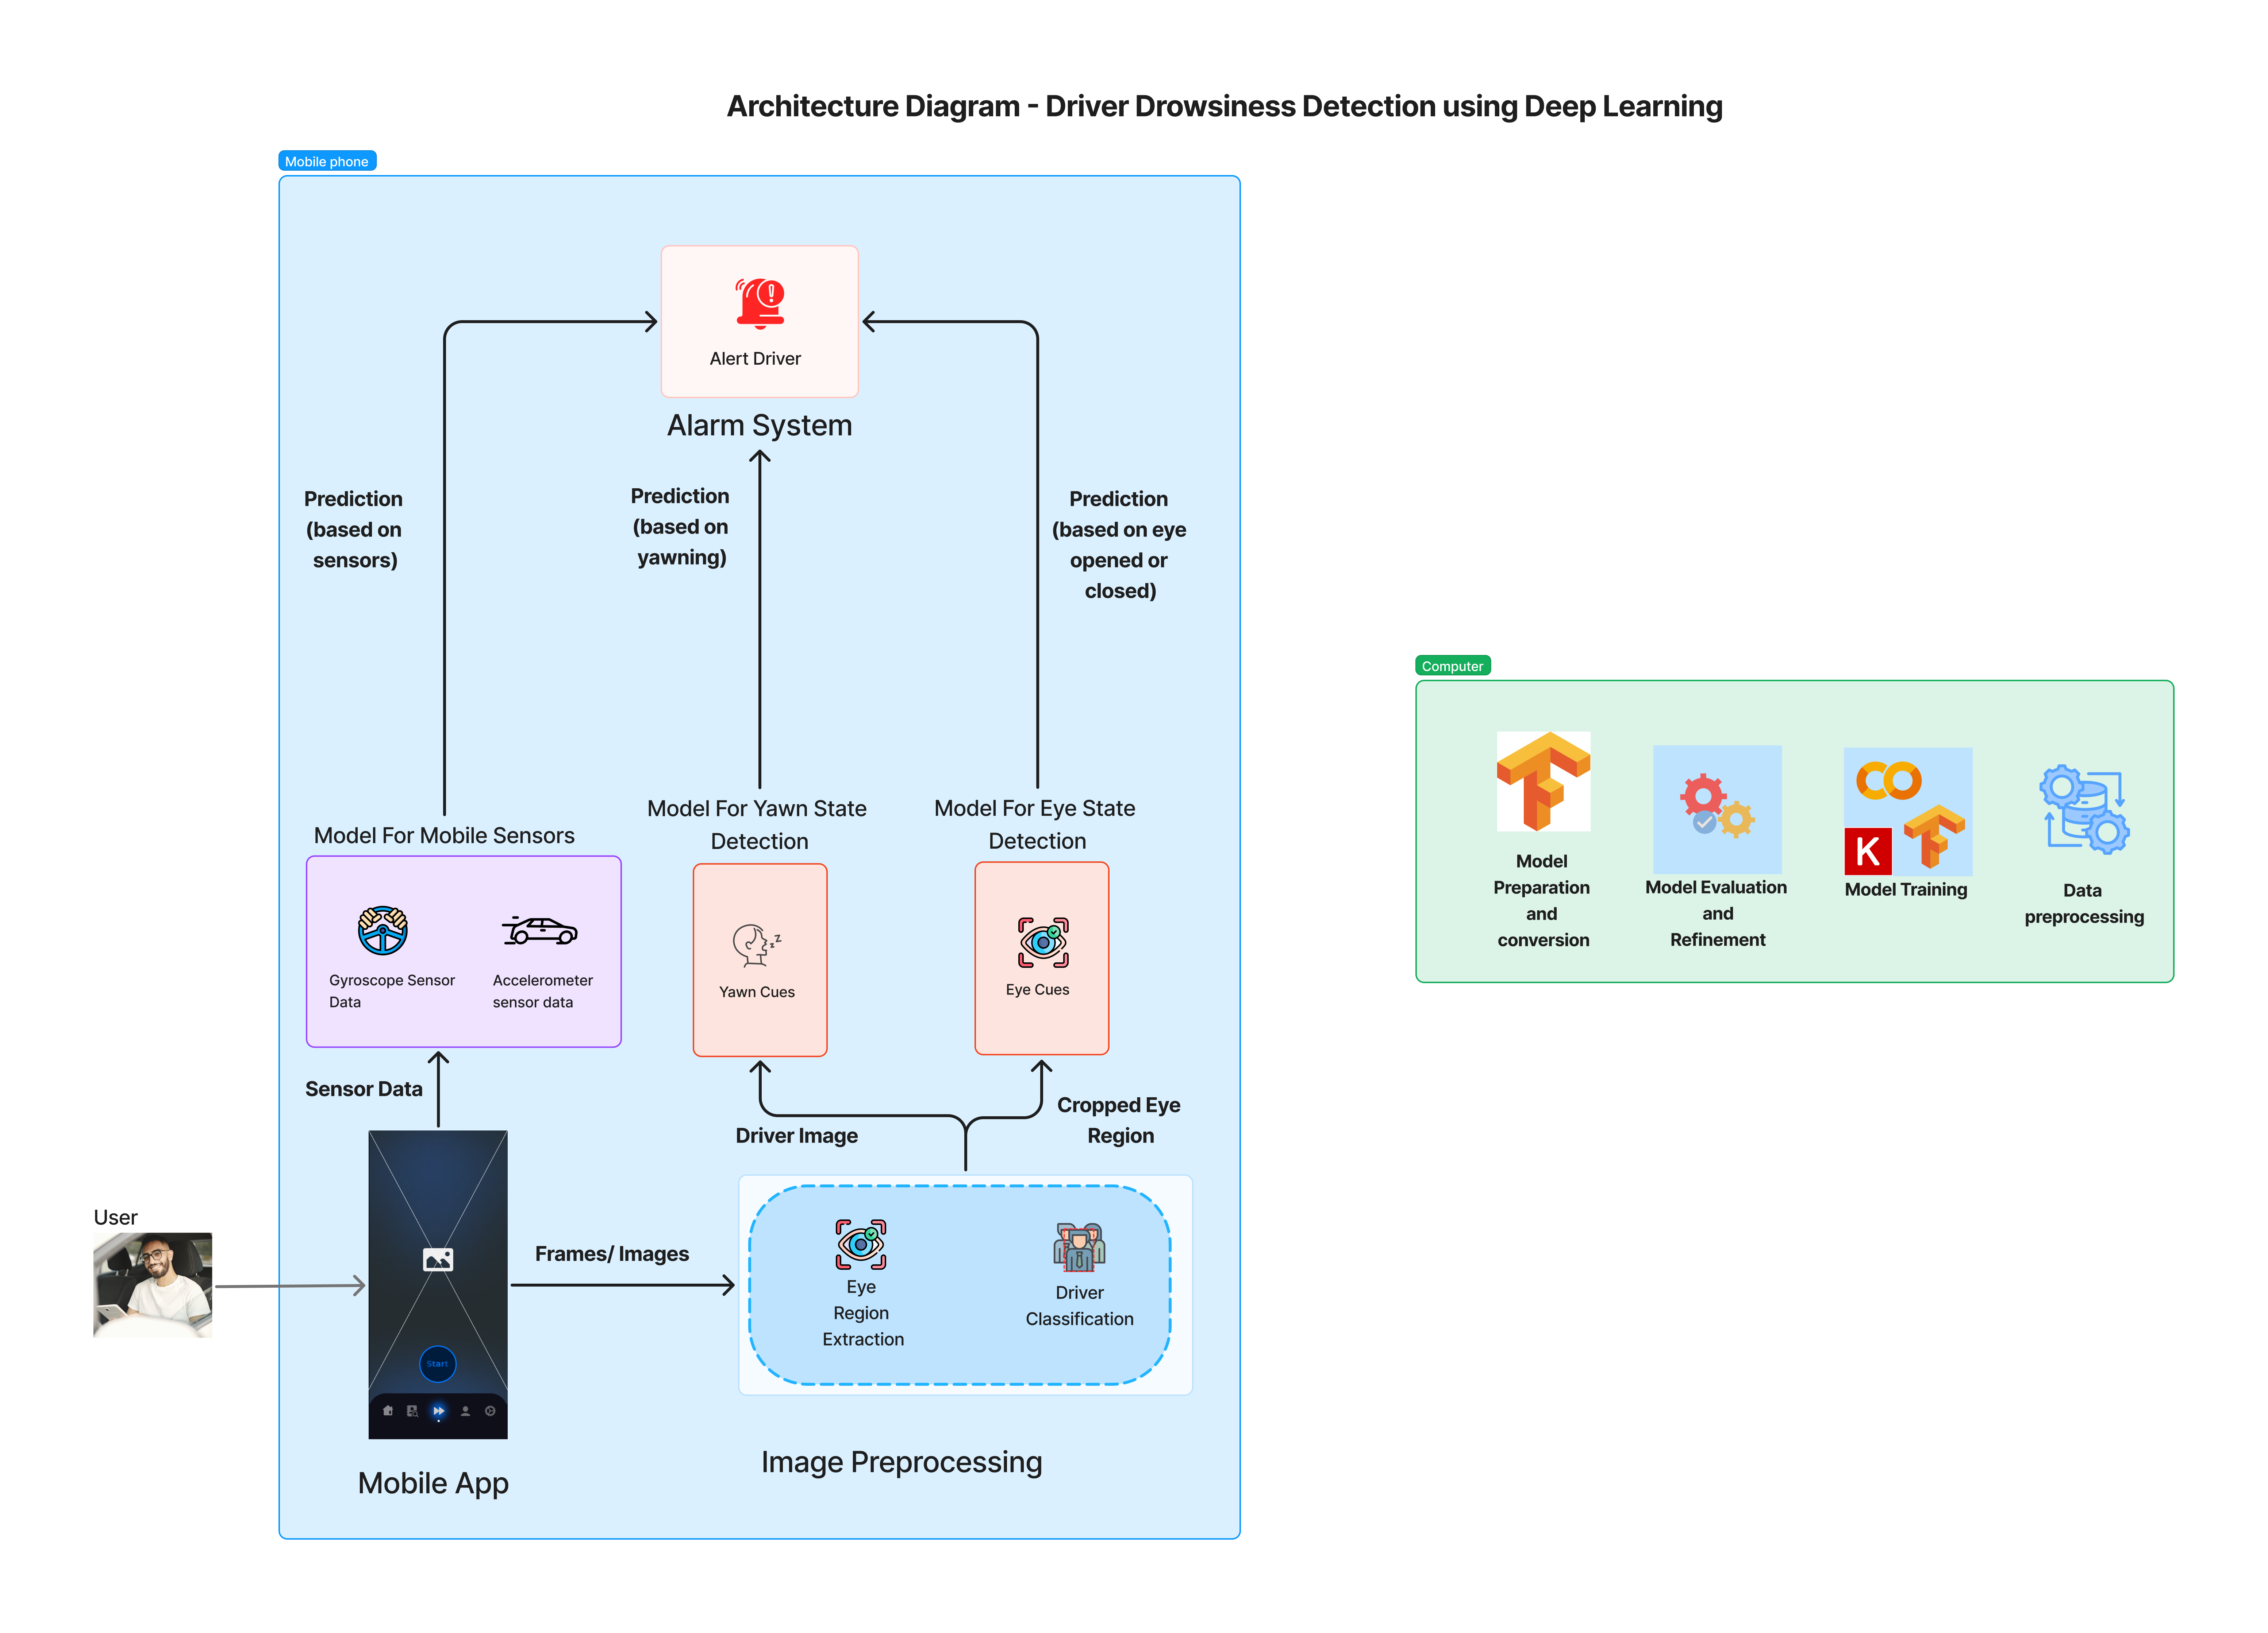

Slide 11
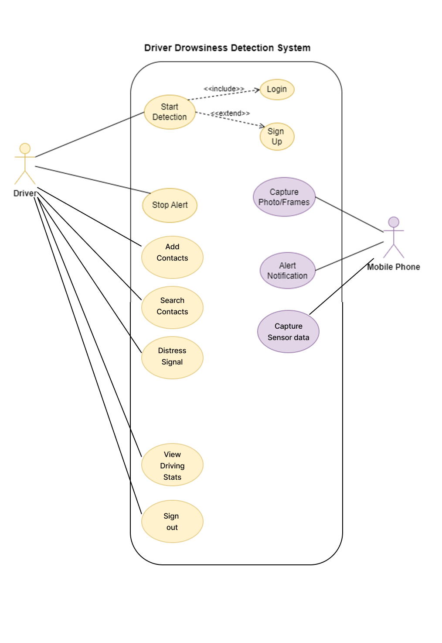
Use Case Diagram

Slide 12
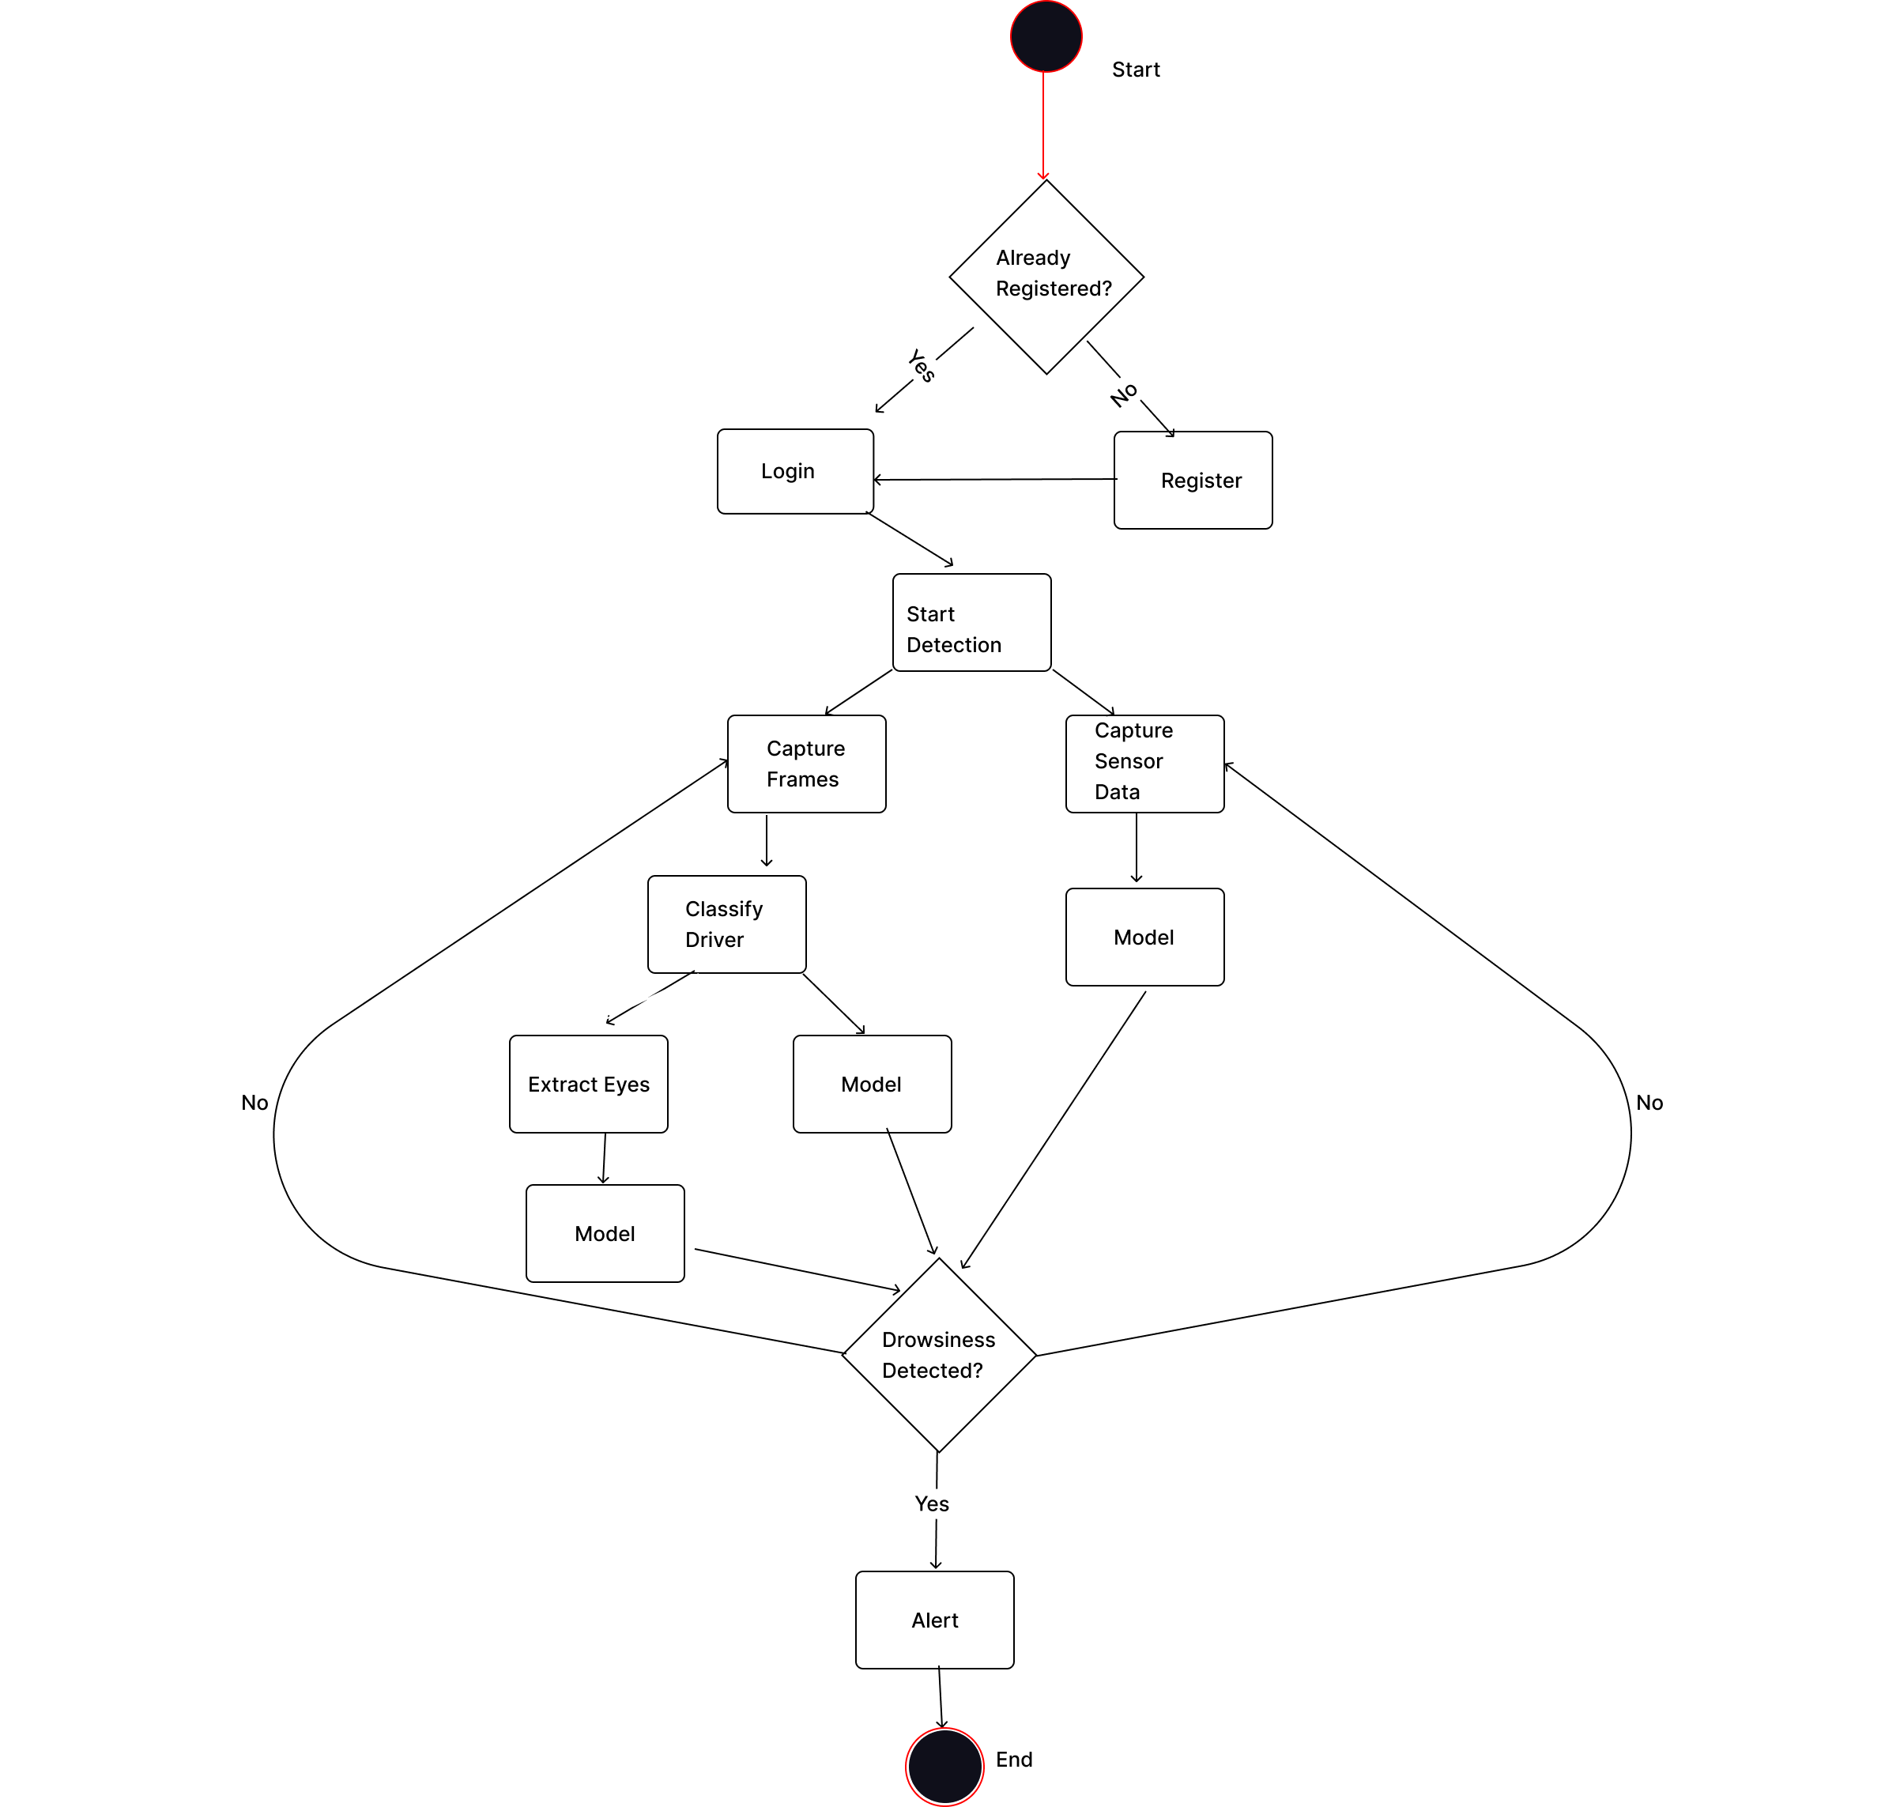
Activity Diagram

Slide 13
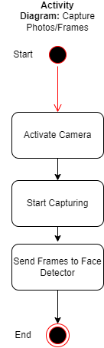
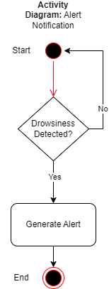
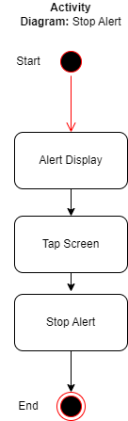
Activity Diagram

Slide 14
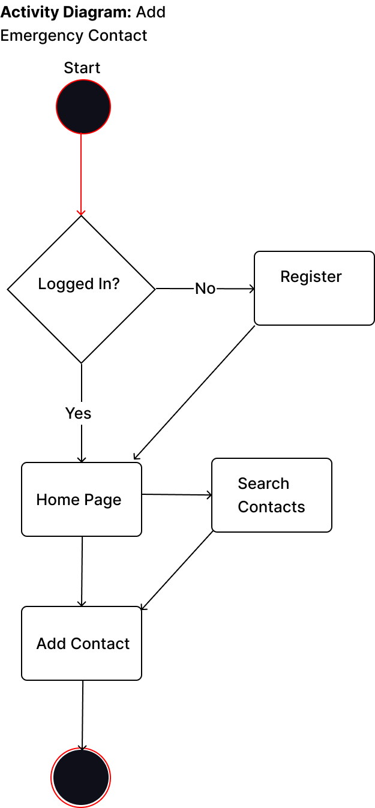
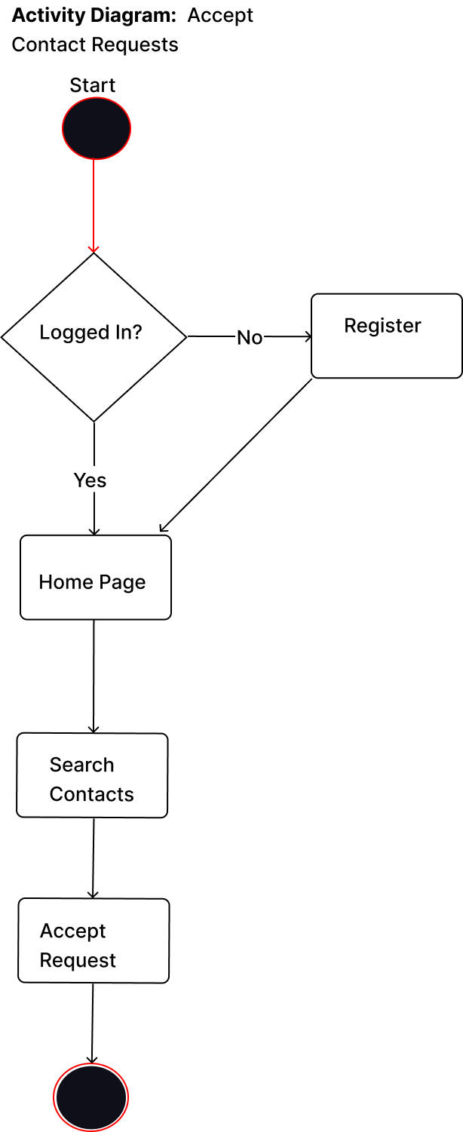
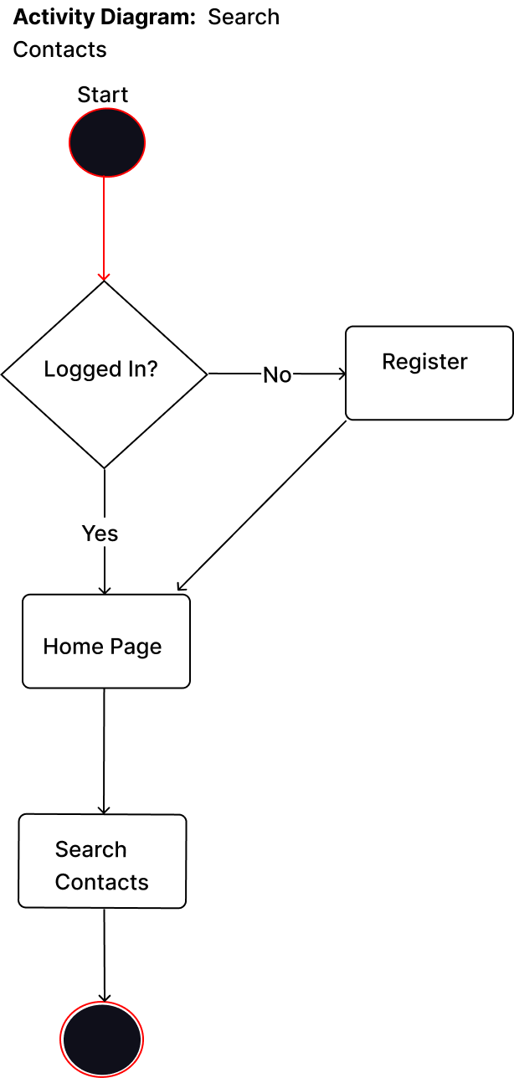

Slide 15
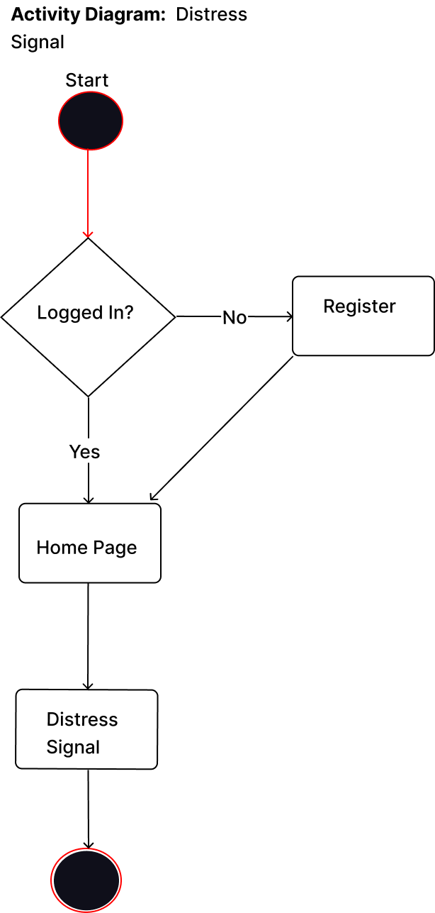
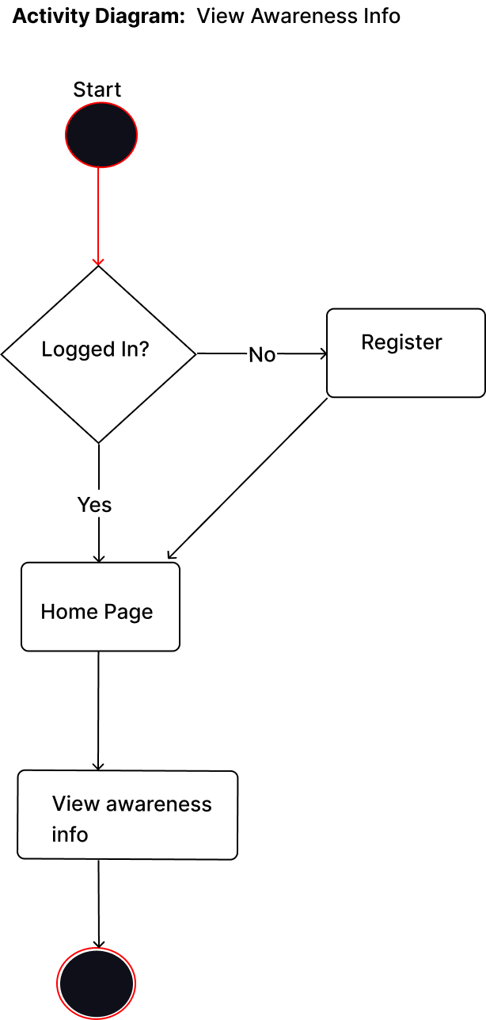


Slide 16
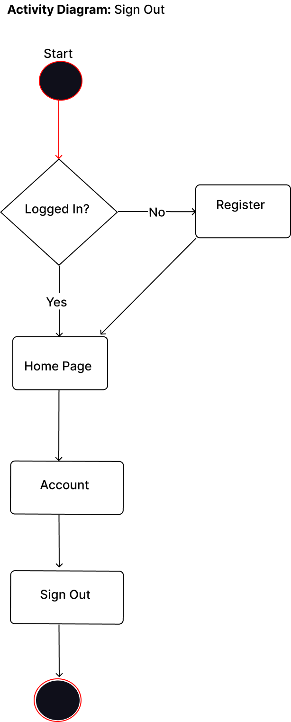

Slide 18
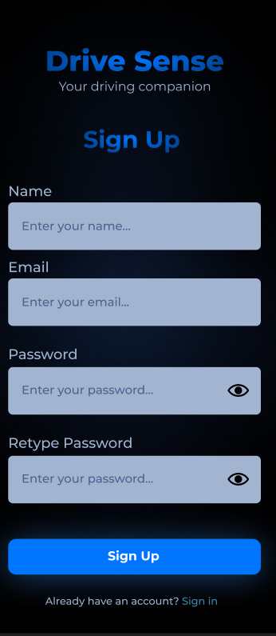
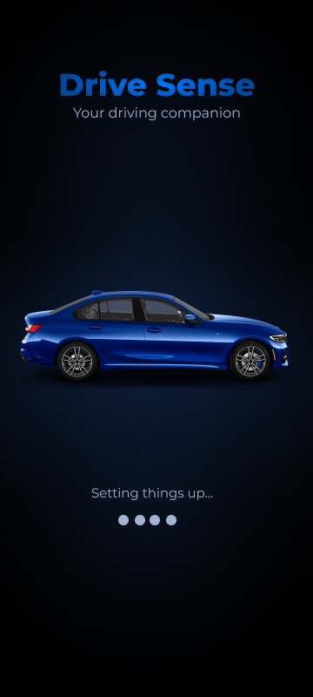
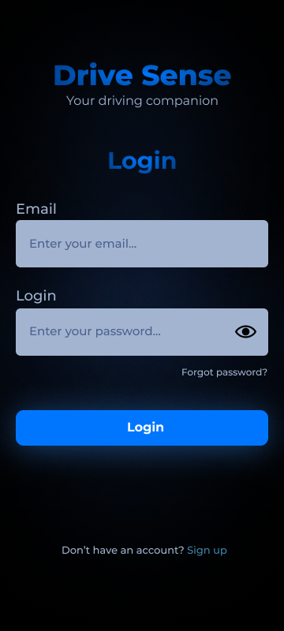
UI/UX

Slide 19
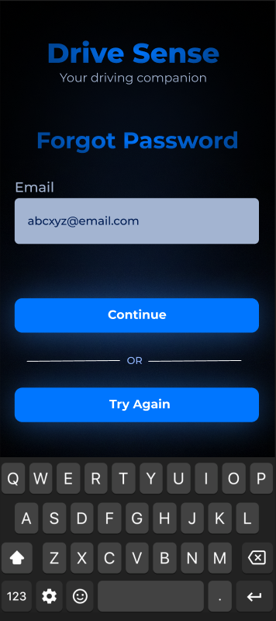
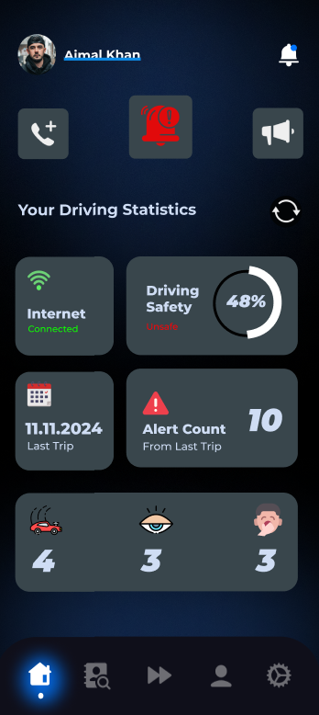
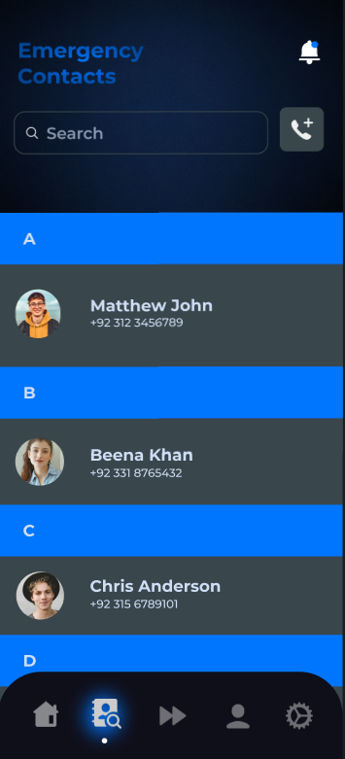

Slide 20
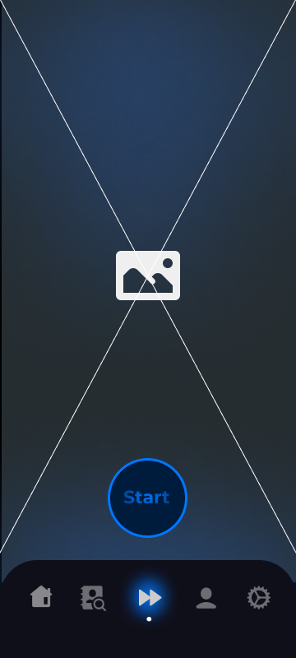
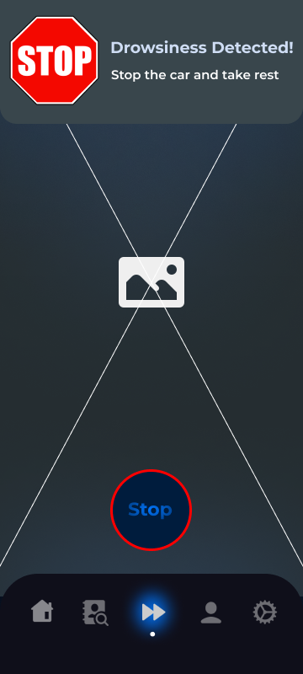
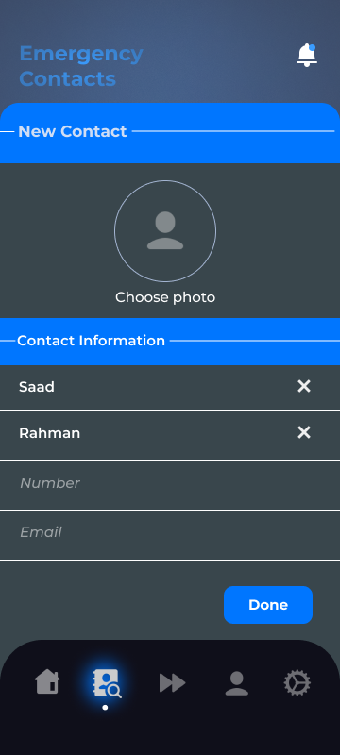

Slide 21
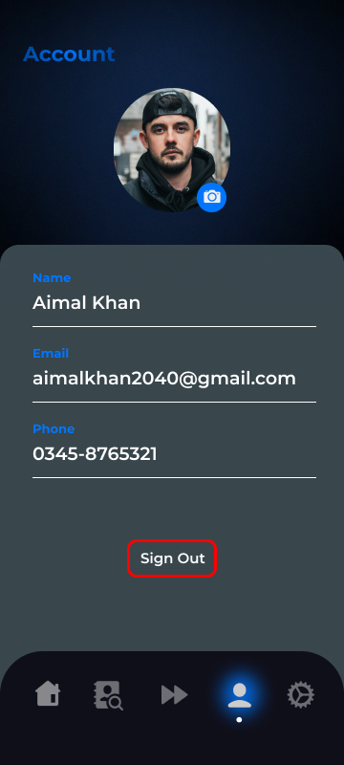
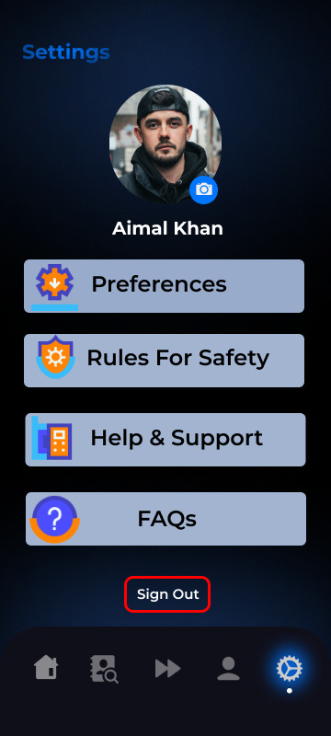

Slide 22
Models:
For Images Classification:
  Custom CNN
  MobileNet
For Sensors Data:
  Random forest
  Dense NN
  LSTM
  CNN-LSTM
  ConvLSTM2D

Slide 23
Models Used (Image Classification):
To detect yawning and eye state comparison was done between MobileNet and Custom CNN.
Custom CNN:
  Computationally expensive
  Requires extensive training
MobileNet
  Lightweight and highly optimized for mobile devices
  Pretrained on ImageNet can provide higher accuracy for detecting complex features

Slide 24
Models Used (MobileNet):
MobileNet:
  MobileNetV2 pre-trained on ImageNet
  Base Layers frozen
  GlobalAveragePooling2D
  Dropout (0.5)
  Dense Layer with Sigmoid and 1 unit
  Optimization: Adam Optimizer and Binary Crossentropy loss

Slide 25
Models Used(custom CNN):
Custom CNN:
  First Conv Block:
    Conv2D (32 filters, 3x3, ReLU, ‘same’ padding)
    BatchNormalization
    MaxPooling2D (2x2)
    Dropout (0.25)
  Second Conv Block:
    Conv2D (64 filters, 3x3, ReLU, ‘same’ padding)
    BatchNormalization
    MaxPooling2D (2x2)
    Dropout (0.25)
  Third Conv Block:
    Conv2D (128 filters, 3x3, ReLU, ‘same’ padding)
    BatchNormalization
    MaxPooling2D (2x2)
    Dropout (0.25)
  GlobalAveragePooling2D

Slide 26
Models Used (custom CNN):
  Fully Connected Layer:
    Dense (256 units, ReLU activation)
    BatchNormalization
    Dropout (0.5)
  Output Layer
    Dense (1 unit, Sigmoid activation for binary classification)
  Optimization
    Adam Optimizer and Binary Crossentropy loss

Slide 27
Image Data Overview:
The dataset already available consists of full person images who is yawning or not yawning and eyes that are open or closed.
Four distinct classes : yawn, no_yawn, open and closed.
Collected from an online repository on kaggle.
Training data having 617 images from each class.
Testing data containing:
  109 images from closed and open classes
  109 images from no_yawn and 106 images from yawn class

Slide 28
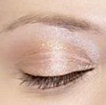
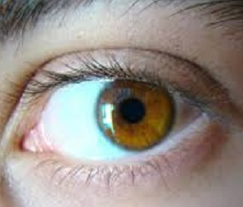
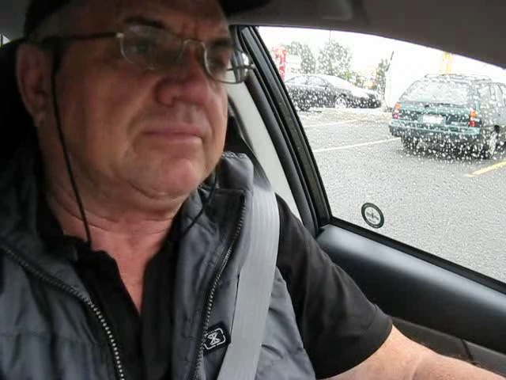
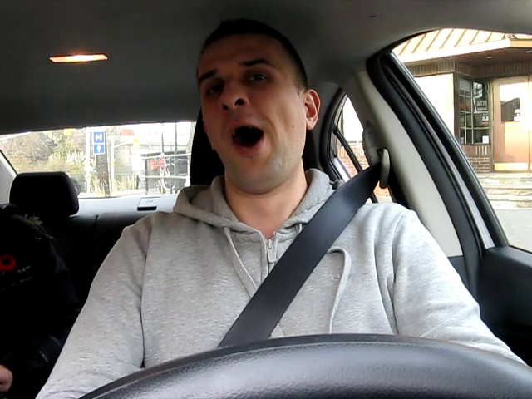
open eye
closed eye
no_yawn
yawn

Slide 29
Preprocessing:
Train-Test Split of 80% and 20%
20% of Training data is reserved for Validation
Image resizing to 224x244
Data Augmentation:
  Rotation of up to 20 degrees applied
  Width & Height shift randomly by 20%
  Shear Transformation by up to 20%
  Zooming in or out by 20%
  Horizontal Flipping
  Brightness adjustment between 20% and 100%
  Filling missing areas of image by nearest neighbouring pixels
  Image Rescaling to normalize them to a range of [0,1]

Slide 30
Accuracy:
MobileNet:
  Eye state: 98% accuracy
  Yawning: 75% accuracy
Custom CNN:
  Eye state: 55% accuracy
  Yawning: 83% accuracy

Slide 31
Models Used (Sensors):
Dense Neural Network
Input Layer:
Dense (192 neurons), input shape (6,)
Hidden Layers: 3 Dense layers:
  First Layer: 320 neurons
  Second Layer: 128 neurons
  Third Layer: 64 neurons
  ReLU activation
Dropout Layer: Dropout (0.2)
Output Layer: Dense (3 neurons, softmax)
Optimizer: Adam, learning rate 0.001

Slide 32
Models Used
Random Forest Classifier:
    Number of Trees: 20
    Maximum depth: 10
    Minimum Samples to Split: 6
    Minimum Samples per Leaf: 4
    Maximum Features: 'auto’
    Bootstrap Sampling: True
    Hyperparameter tuning using RandomizedSearchCV with
    a 5-fold cross-validation
    Optimized using RandomizedSearchCV to find the best parameters

Slide 33
Models Used
LSTM:
Input Layer: LSTM (Units: 256, Input Shape: (TIMESTEPS, FEATURES))
Hidden Layers:
LSTM (Units: 128, Dropout: 0.2, Return Sequences: True)
LSTM (Units: 64, Dropout: 0.3, Return Sequences: True)
LSTM (Units: 32, Dropout: 0.1, Return Sequences: False)
Dropout Layer: Dropout Rate: 0.2
Dense Layer: Units: 64
Output Layer: Dense (Units: 2, Activation: Softmax)

Slide 34
CNN-LSTM:
Input Layer:
TimeDistributed Conv1D (Filters: 32, Kernel Size: 3, Activation: ReLU)
Convolutional Layers:
TimeDistributed Conv1D (Filters: 64, Kernel Size: 3, Activation: ReLU)
TimeDistributed Conv1D (Filters: 128, Kernel Size: 3, Activation: ReLU)
Dropout (Rate: 0.3)
TimeDistributed MaxPooling1D (Pool Size: 2)
Flatten Layer:
TimeDistributed Flatten
LSTM Layers:
LSTM (Units: 64, Dropout: 0.2, Return Sequences: True)
LSTM (Units: 32, Dropout: 0.2, Return Sequences: True)
LSTM (Units: 16, Dropout: 0.1, Return Sequences: False)
Dropout Layer:
Dropout (Rate: 0.2)
Dense Layer:
Dense (Units: 64, Activation: ReLU)
Output Layer:
Dense (Units: 2, Activation: Softmax)

Slide 35
Models Used
ConvLSTM2D:
Input: ConvLSTM2D (Filters: 32, Kernel Size: (1,3)
  Activation: ReLU, Input Shape: (4, 1, 10, 6))
Dropout: 0.3
Flatten:
Dense: 128 Units, Activation: ReLU
Output: Dense (2 Units, Softmax)
Optimizer: Adam (LR: 0.001)
Loss: Binary Crossentropy

Slide 36
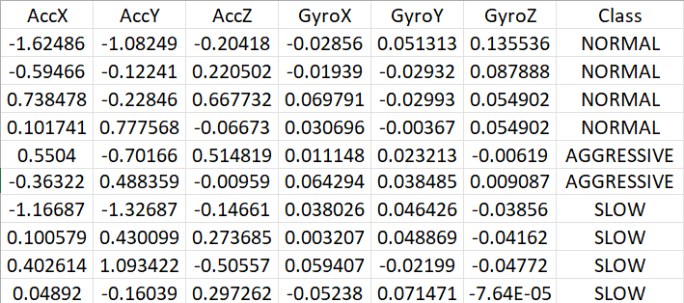
Sensor Data Overview:

Slide 37
Sensor Data Overview:
The Dataset, collected from a recent research paper available at this link having accelerometer (AccX, AccY, AccZ) and gyroscope (GyroX, GyroY, GyroZ) sensors to monitor driver behavior.
Three distinct driving behavior classes: Normal, Slow, and Aggressive.
Time series data labeled by class to analyze sequential driving patterns.
Noise present at the start and end of sequences due to transitions between classes was filtered out to improve data quality.

Slide 38
Data Representation and Preprocessing:
Sensor data, with six features in total, was standardized using StandardScaler to normalize the range of values.
Data reshaping was applied where needed to fit specific model input requirements (e.g., reshaped into 5D arrays for ConvLSTM2D).
Class labels were converted into categorical binary format for efficient model training.
To ensure balance between classes and avoid bias, excess samples from overrepresented classes were removed.

Slide 39
Models Accuracy and Testing:
We evaluated multiple algorithms such as XGBoost, Dense Neural Networks (NN), Random Forest, and others to identify the most accurate model.
We compared the performance of models for both the 3-class classification (Normal, Slow, Aggressive) and 2-class classification (Normal, Aggressive). The aim was to assess model accuracy in different scenarios.
Overall the model Performed better in 2-class scenario with ConvLSTM2D achieving the highest accuracy at 84%.
Comparison Graphs on Next slide.

Slide 40
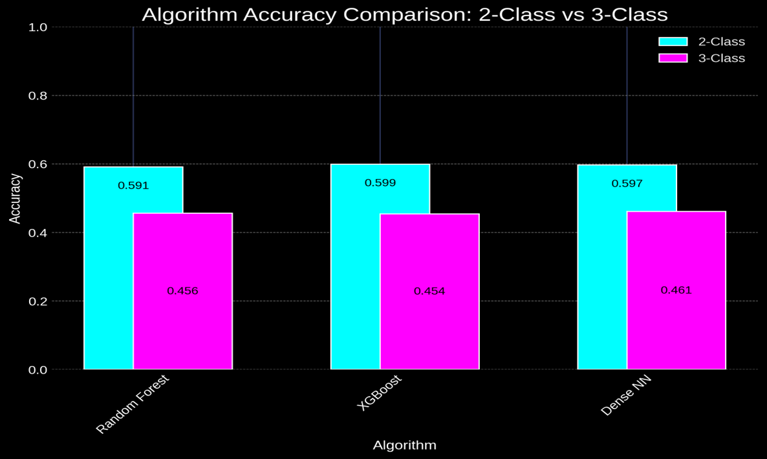

Slide 41
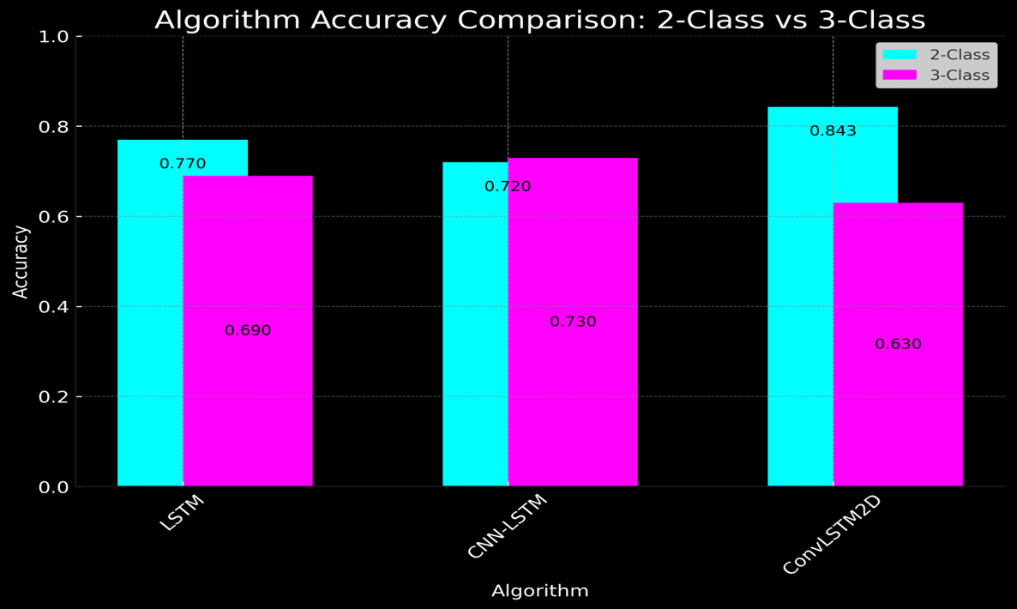

Slide 42
Challenges:
Latency in decision making
Battery consumption
Low light conditions
Dataset diversity
Resource constraints
Noisy Data
Imbalanced Classes
Missing Data

Slide 43
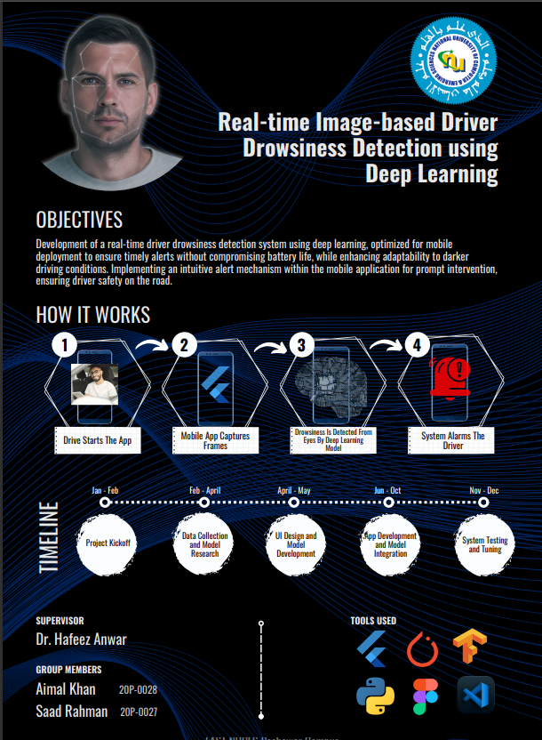
Poster

Slide 44
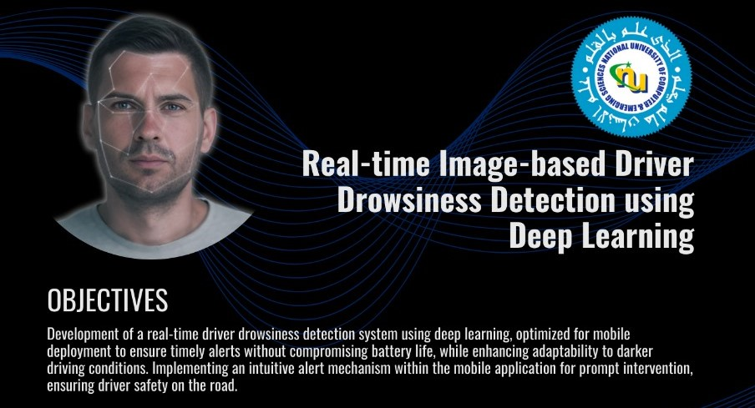
Objectives

Slide 45
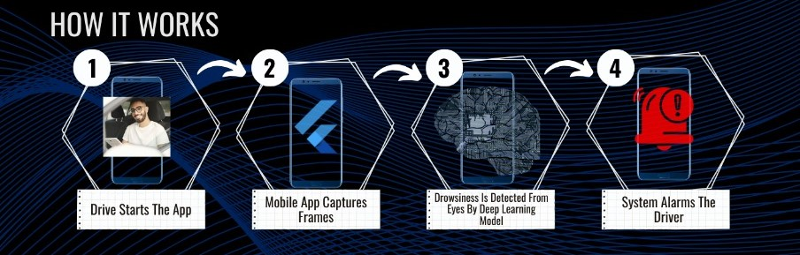
Working

Slide 46
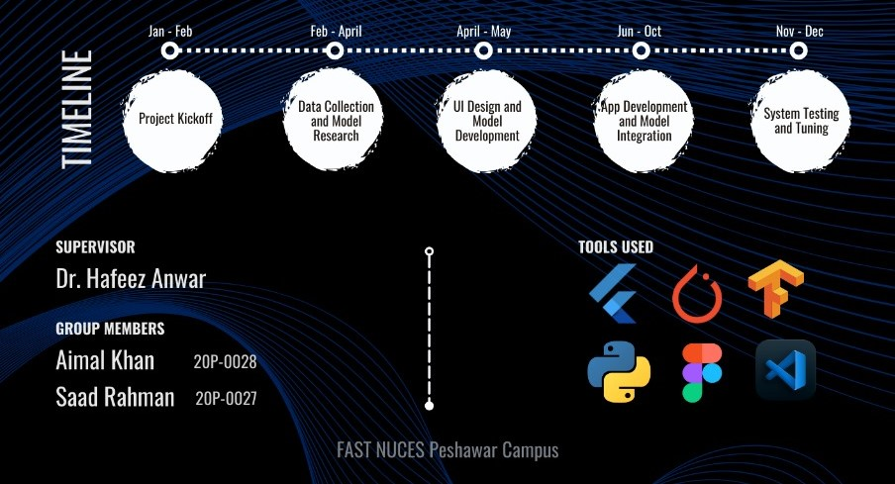
Timeline & Tools Used

Slide 47
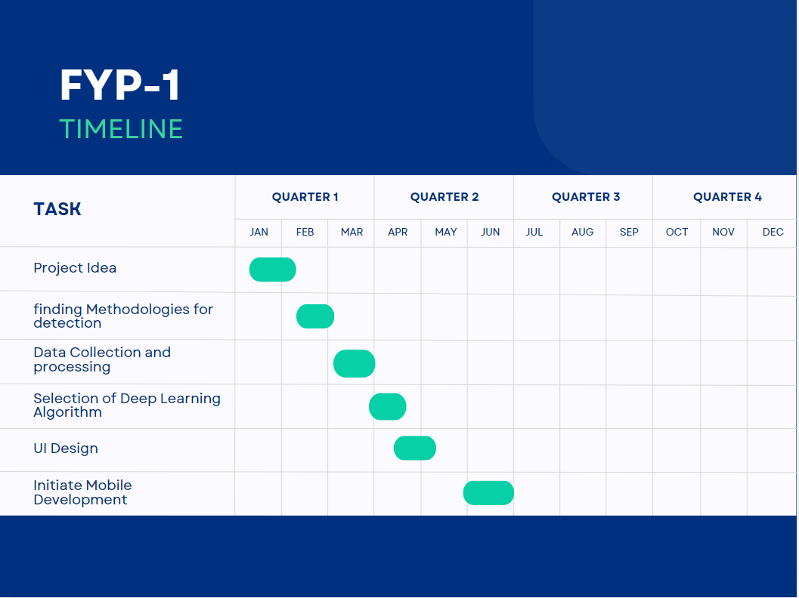
Gantt Chart (Project Timeline)

Slide 48
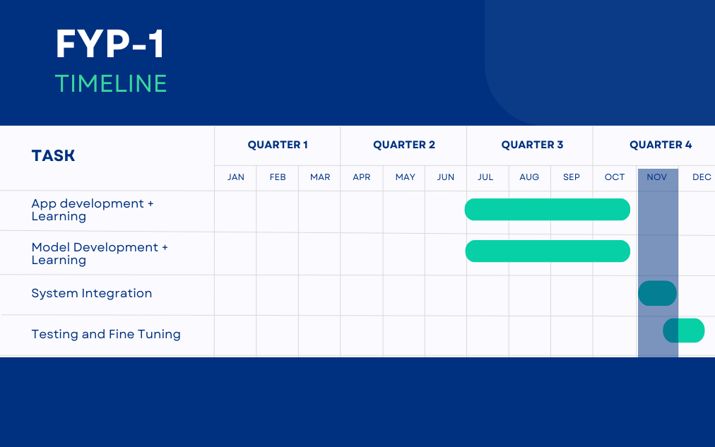
Gantt Chart (Project Timeline)

Slide 49
Expected Result
Accurate real-time detection of driver drowsiness.
Effective alarm generation to prevent potential accidents.
User-friendly mobile application with responsive alert system.

Slide 50
Team Work
Saad Rahman
Aimal Khan
Architecture and Use Case Diagram
Literature Review
Documentation
Data collection and pre-processing.
Finding the appropriate deep learning architecture for image classification.
Model Training and Testing.
UI Design
Backend Development to integrate the Mobile Application to the server.
Model Integration.
Deployment.
Testing the server.
Analysis and Sequence Diagram
Literature Review
Documentation
Data collection and pre-processing.
Finding the appropriate deep learning architecture for image classification.
Model Training and Testing.
UI Design
Mobile Application development for capturing real-time images.
Model Integration.
Deployment.
Testing the application.

Slide 51
Literature Review
Sr. No. | Year | Basic Idea | Methodologies | Results | Limitations
1 | 2023 | The paper introduces DrowsyDetect, an Android app utilizing deep learning (MobileNet, VGG16, custom CNN) to detect driver drowsiness by analysing eye closure rate. | - Models: MobileNet, VGG16, Custom CNN - Feature Extraction: Haar Cascade for faces and eyes - Data Preprocessing: Normalization, Serialization (pickle) - Training: 15 epochs, learning rate 0.1, binary cross-entropy loss, Adam optimizer, Sigmoid activation | - MobileNet and VGG16 both achieved 100% accuracy - VGG16 reached 100% accuracy after 615 epochs - Custom CNN model attained 98.75% accuracy after 1015 epochs - MobileNet and VGG16 outperformed the custom CNN model | - The study didn't explore integrating complex features like sleep schedules or emergency triggers - Focused solely on eye closure rate - Limited dataset potentially impacting model generalizability - Challenges with Haar Cascade for feature extraction weren't discussed

Slide 52
2 | 2023 | The paper presents a real-time driver drowsiness detection system using CNNs, integrating eye blink analysis and yawning detection. It involves video extraction, preprocessing, and CNN-based classification. | - Employed SSD MobileNet V2 FPNLite 320x320 pre-trained model - Optimized for speed and efficiency in drowsiness detection - Training involved a dataset of yawning and blinking images to enhance accuracy | - The deep learning model achieved a drowsiness detection accuracy of 62-87% - Mean Average Precision (mAP): 0.595 at 5000 training steps, 0.56 at 7000 training steps - Average Recall (AR100(Large)): 0.686 at 5000 training steps, 0.662 at 7000 training steps | - Model's accuracy ranged from 62-87%, suggesting potential for higher consistency in drowsiness detection - Mean Average Precision (mAP): 0.595 - Average recall (AR100(Large)): 0.662 - Room for improvement in precision and recall metrics - User Acceptance Testing (UAT) involved only a small sample size of seven participants, potentially limiting generalizability

Slide 53
3 | 2023 | The paper presents a real-time driver drowsiness detection system using CNNs, incorporating eye blink analysis and yawning detection. Steps involve video extraction, preprocessing, data augmentation, and CNN-based classification. | - Convolutional Neural Networks (CNNs) used for driver drowsiness detection - Integrated eye blink analysis and yawning detection - Specific CNN model with 3 convolution layers and ReLU activation functions for yawning feature extraction - Architecture included Conv2D and MaxPooling layers for efficient image classification | - Proposed Convolutional Neural Network model achieved 95% accuracy for driver drowsiness detection - ConNN algorithm demonstrated superior accuracy rates of 99% compared to existing CNN-based methods for recognizing driver fatigue conditions - Yawning detection evaluation metrics: precision 0.9207, recall 0.8774, F1 score 0.8985 | - The study lacks information on how well the proposed model would generalize to different datasets and real-world scenarios - Indicates a need for further validation - More testing needed to assess the model's performance across diverse driving conditions - Larger dataset required for comprehensive evaluation

Slide 54
5 | 2023 | The paper introduces a real-time system using computer vision and machine learning to detect driver drowsiness. It aims to address road safety concerns, especially in India.Machine learning, particularly a Convolutional Neural Network (CNN), is integrated to accurately identify signs of driver fatigue. | - System employs computer vision, machine learning, and sensor integration for drowsiness detection - Data preprocessing techniques applied during training - Convolutional Neural Network (CNN) model used for prediction - Architecture integrates a CNN-based machine learning algorithm for sleepiness detection - Includes a user-friendly interface | - Developed drowsiness detection application achieved an F1 score of 89% - Demonstrates balanced performance in precision and recall - Outperformed existing solutions in accuracy, precision, recall rates, and overall F1 score - Indicates effectiveness in identifying drowsiness levels and minimizing false positives | - Lack of extensive investigations into incorporating machine learning algorithms into user-friendly mobile applications customized for specific geographical locations like India - Scarcity of user studies assessing the usability, efficacy, and real-world implications of the drowsiness detection application - Further research needed to authenticate the practical usefulness of the developed application in real-world scenarios

Slide 55
4 | 2023 | The study focuses on real-time drowsiness detection using MobileNet, a deep convolutional neural network. MobileNet's design prioritizes efficiency for mobile devices, making it suitable for applications like real-time drowsiness detection. | - Employed facial feature extraction and classification for drowsiness detection - Analyzed data collected from cameras monitoring the driver's face using machine learning algorithms - Used a combination of Haar-like features and the AdaBoost algorithm for eye state analysis - Head pose analysis utilized a particle filter-based algorithm - Drowsiness detection conducted using the MobileNet V1 architecture | - Drowsiness detection system, utilizing MobileNet V1 architecture, achieved an accuracy of 97.45% - Overall accuracy in detecting driver sleepiness: 92.6% - Proposed method for eye state analysis achieved an accuracy of 94.23% in detecting drowsiness | - Study concentrated on drowsiness detection using MobileNet without exploring other deep learning architectures for comparison - Emphasized facial feature extraction and classification, potentially neglecting other physiological indicators of drowsiness - System's performance evaluation based on specific datasets and conditions, possibly restricting generalizability to diverse real-world scenarios

Slide 56
6 | 2020 | The paper focuses on real-time driver drowsiness detection using a lightweight neural network approach. It analyzes facial landmarks captured by a camera and processed by a Convolutional Neural Network (CNN) for classification. | - Utilized facial landmarks detected by a camera - Processed through a Convolutional Neural Network (CNN) for drowsiness classification - Video preprocessing involved extracting images from video frames in 4 stages - Incorporated MaxPooling and ReLU functions - System detected facial landmarks from mobile device images - Fed them into a CNN-based trained Deep Learning model for detecting drowsy driving behavior. | - D2CNN-FLD method achieved an 83.3% overall accuracy in detecting driver drowsiness - Displayed significant reductions in size, complexity, and storage compared to the older D2MLP-FLD model, with a maximum size of 75 KB - Drowsiness detection time for D2CNN-FLD was 38.45 ms on a Dell workstation with NVIDIA Quadro P4000. | - Technology may face limitations when facial features are obstructed by sunglasses or under poor lighting conditions - Improvement opportunities exist in enhancing facial feature detection, particularly in challenging lighting environments

Slide 57
7 | 2019 | The paper introduces a method for real-time drowsiness detection in surveillance videos by analyzing eyelid closure using face detection and eyelid curvature detection. It involves detecting faces with the Viola-Jones algorithm, identifying the driver's face, and analyzing the eye region for eyelid curvature. Closed eyelids are detected based on concave curves, with upward curves indicating closure and downward curves indicating open eyes. | - Viola-Jones object detection algorithm used for face detection - Eyes extracted for further analysis - Eyelid curvature determined using a modified Sobel operator to detect eyelid closure - Eyes classified as open or closed based on this curvature - Method achieved high classification accuracy across different datasets - Effectiveness demonstrated for real-time drowsiness detection | - Achieved up to 95% accuracy on a uniform background dataset - 70% accuracy on a benchmark dataset with varied face deformations - Maintained 95% accuracy in real-time video datasets - Eyelid curvature detection and eye classification had a 97% accuracy relative to eye detection - Correct eye classification observed in the benchmark dataset, with some incorrect results - Overall, the method effectively detected open and closed eyes | - Dataset limitations stem from the rejection of images with severe out-of-plane and in-plane rotations, impacting the dataset's representativeness - Accuracy of the proposed method relies on eye detection accuracy, which was 98% - This accuracy level influences the overall relative accuracy

Slide 58
References
[1]. Asim, F., & Sunil, S. (2023). DrowsyDetect: Android Application for Driver Drowsiness Detection Using Eye Closure Rate with Deep Learning. Journal of Student Research. Retrieved from https://www.jsr.org/index.php/path/article/view/2152
[2]. F. Ridwan and L. P. Hung, "Driver-Drowsiness Detection System Using Deep Learning (CNN)," 2023 IEEE International Conference on Artificial Intelligence in Engineering and Technology (IICAIET), Kota Kinabalu, Malaysia, 2023, pp. 78-83, doi: 10.1109/IICAIET59451.2023.10291637.
[3]. M. Shereesha, G. Sreehitha, G. R. Reddy, J. Srikanth and H. R. Varma, "Driver Drowsiness Detection using Convolutional Neural Networks(CNNs)," 2023 4th IEEE Global Conference for Advancement in Technology (GCAT), Bangalore, India, 2023, pp. 1-5, doi: 10.1109/GCAT59970.2023.10353337.

Slide 59
[4]. S. S. Bharti, R. Mahajan, S. Bhoriya and A. Bhat, "Driver’s Drowsiness Detection using MobileNet on Web," 2023 7th International Conference on Intelligent Computing and Control Systems (ICICCS), Madurai, India, 2023, pp. 1229-1233, doi: 10.1109/ICICCS56967.2023.10142379.
[5]. A. Ritesh, N. Jagatia and P. Deshmukh, "Driver Drowsiness Detection Using Machine Learning," 2023 6th International Conference on Advances in Science and Technology (ICAST), Mumbai, India, 2023, pp. 100-105, doi: 10.1109/ICAST59062.2023.10455018
[6]. R. Jabbar, M. Shinoy, M. Kharbeche, K. Al-Khalifa, M. Krichen and K. Barkaoui, "Driver Drowsiness Detection Model Using Convolutional Neural Networks Techniques for Android Application," 2020 IEEE International Conference on Informatics, IoT, and Enabling Technologies (ICIoT), Doha, Qatar, 2020, pp. 237-242, doi: 10.1109/ICIoT48696.2020.9089484
[7]. Tayab Khan, M., Anwar, H., Ullah, F., Ur Rehman, A., Ullah, R., Iqbal, A., Lee, B.-H., & Kwak, K. S. (2019). Smart Real-Time Video Surveillance Platform for Drowsiness Detection Based on Eyelid Closure. Wireless Communications and Mobile Computing, 2019, 2036818. doi:10.1155/2019/2036818

